Slide 1
AI-Enabled Social Cyber Maneuver Detection and Creation
Matthew Hicks
Thesis
Spring 2024
Committee
Kathleen M. Carley, Chair
Patrick S. Park
Mohamed Farag
David M. Beskow (United States Military Academy)

Slide 2
Outline
Introduction
Background/Doctrinal BEND
AI-Enabled BEND Scenario Development
Generating Synthetic Data for BEND Training
BEND-Effects and Improving the BEND Framework
Conclusions

Slide 3
Social-Cyber Security
BEND provides a framework for describing information space maneuvers
BEND allows us to frame:
(Source) Who
(Payload) Maneuver
(Target) On Whom
(Effect) Impact
Narrative Maneuvers |  |  | Network Maneuvers
Impact what is being said and how it is being said |  |  | “Community” maneuvers. Alter who is connected to whom, the strength of those connections, and so alters who is influential and what groups exist
Emotional Messaging | Develop Narrative | Counter Narrative | Individual Centric | Make Groups | Unmake Groups
Excite | Explain | Distort | Back | Build | Narrow
Dismay | Engage | Dismiss | Negate | Bridge | Neutralize
 | Enhance | Distract |  | Boost | Neglect

Slide 4
Major questions and motivation
Q1: How does the BEND framework fit into current US military doctrine and how can it enhance current information environment analysis?
Q2: How can we develop exercise training scenarios for the BEND framework?
Q3: How can we create synthetic data w/ BEND maneuvers to support a training scenario?
Q4: How can we detect the presence of BEND maneuvers through their effects? Can we tie these effects to broader social media campaigns?

Slide 5
Purpose
The purpose of this thesis is to:
Move BEND beyond a theoretical discussion framework and into an operationally relevant construct for evaluating social-cybersecurity
Develop applications and methods for creating social media training scenarios that are realistic by leveraging generative AI
Develop applications and methods for creating the synthetic social media datasets through the use of generative AI that match a created scenario while mirroring real world data
Develop methods for detecting the effects of BEND maneuver within topic groups and connect these effects to broader campaigns
Notes:
The purpose of this thesis is to move BEND beyond a theoretical discussion framework and into an operationally relevant construct for evaluating social-cybersecurity; this is is accomplished by nesting BEND within current US military doctrine, identifying countermeasures to BEND maneuvers, connecting detected maneuver effects with broader BEND campaigns, and ultimately leveraging AI to develop synthetic training scenarios that closely mirror real word data with minimal human intervention.

Slide 6
Doctrinal BEND

Slide 7
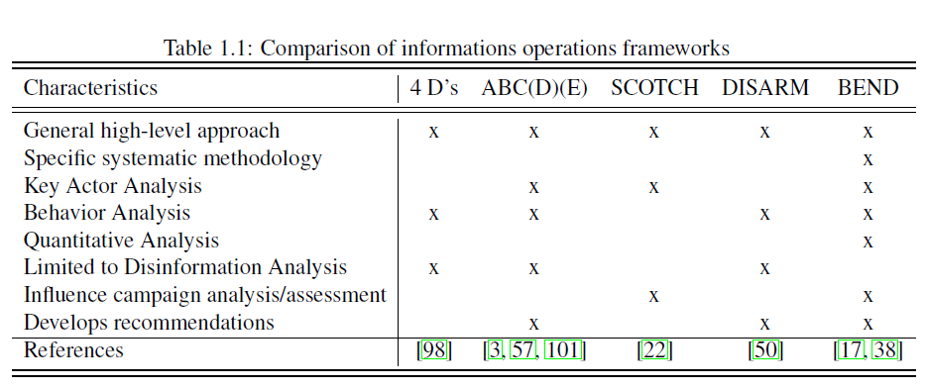
Prior Work
Blaine (CMU-S3D-23-102) looked at and compared BEND to four other frameworks.
Compared BEND to four other information operations frameworks:
Ben Nimmo: 4Ds
ABCDE Framework
Camille Francois: ABC Framework
Alexandre Alaphilippe: ABCD Framework
Pamment: ABCDE Framework
Blazek: SCOTCH Framework
DISARM Foundation: DISARM Framework
BEND’s strength is in its shorthand
Notes:
he ABCDE Framework Actor What kinds of actors are involved? This question can help establish, for example, whether the case involves a foreign state actor. Behavior What activities are exhibited? This inquiry can help establish, for instance, evidence of coordination and inauthenticity. Content What kinds of content are being created and distributed? This line of questioning can help establish, for example, whether the information being deployed is deceptive. Degree What is the overall impact of the case and whom does it affect? This question can help establish the actual harms and severity of the case. Effect What is the overall impact of the case and w
S – Source
C – Channel
O – Objective
T – Target
C – Composition
H – Hook DISARM-STIX for disinformation objects, including actors, behaviours, narratives and artifacts - this makes it easy for DISARM data to be passed between ISAOs and similar bodies using standards like TAXII.
DISARM Red for disinformation creation behaviours
DISARM Blue for disinformation countermeasure and mitigation behaviours.
Disinformation Analysis & Response Measures

Slide 8
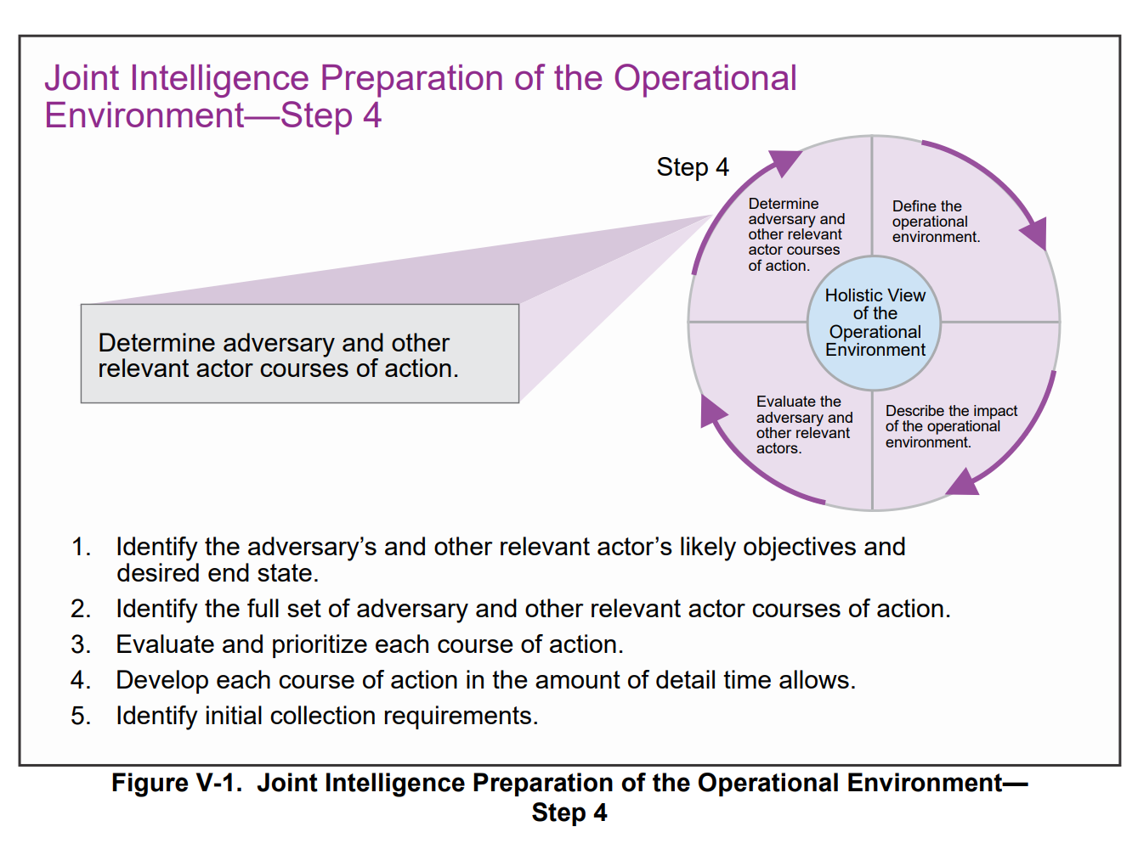
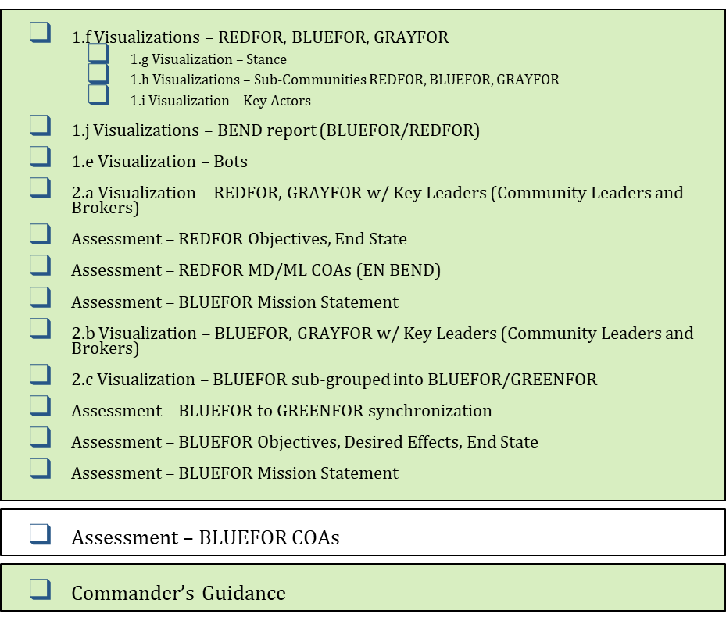
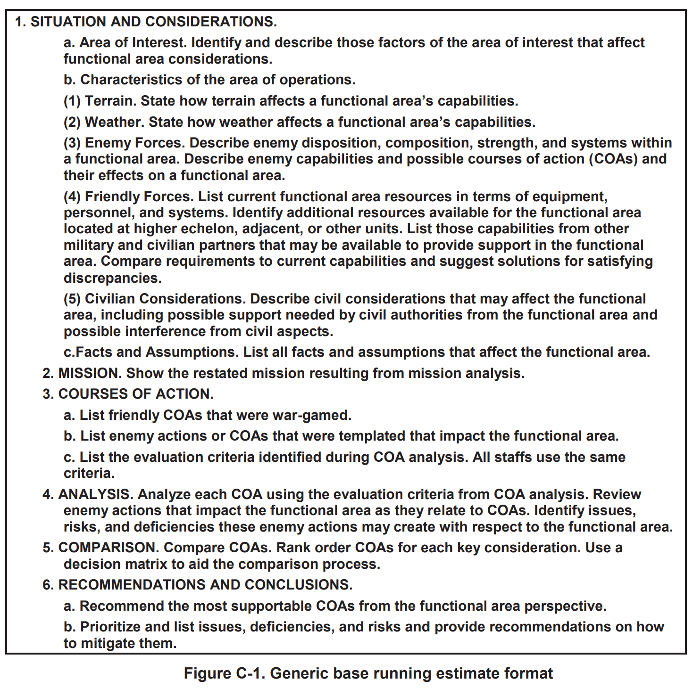
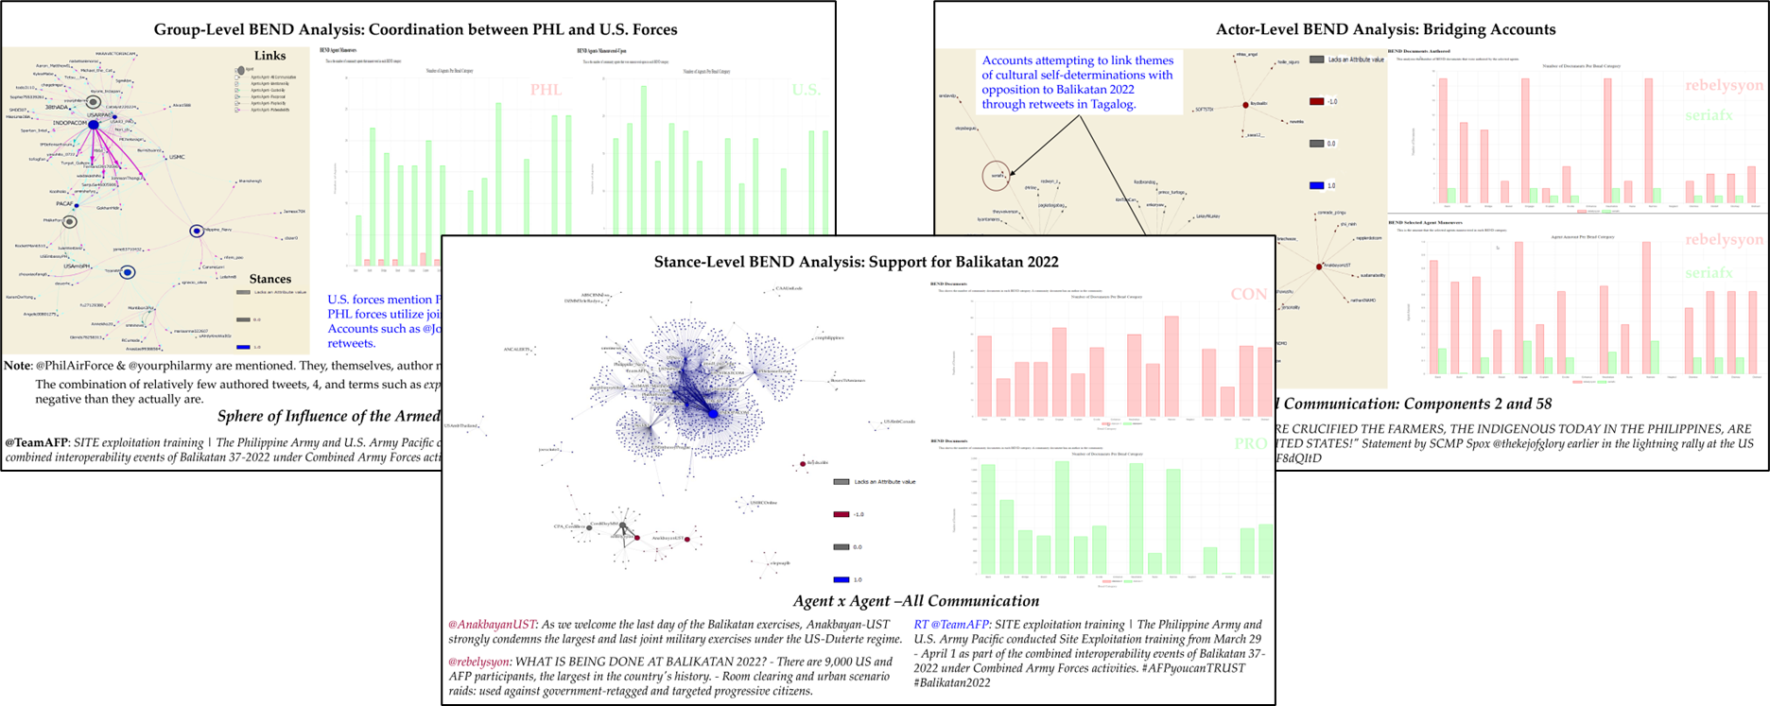
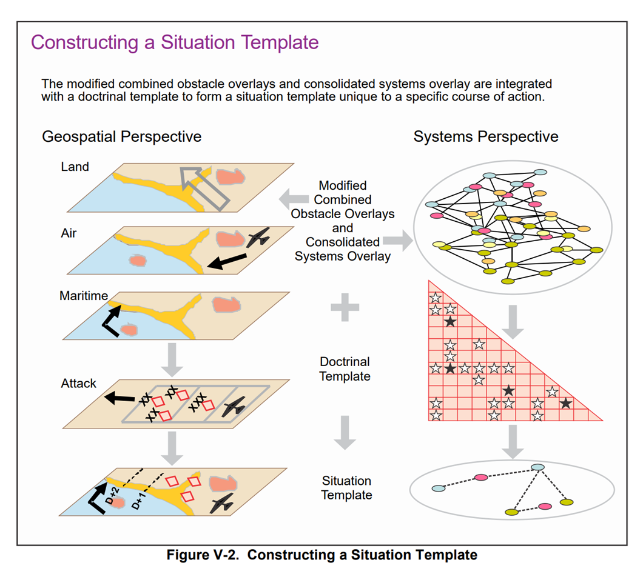
How does the BEND framework fit into current military doctrine?
Current References
Current Products
New References and Products
JP 3-04 Information in Joint Operations
JP 3-13 Information Operations
NWP 3-13 Navy Information Operations
FM 3-13 Information Operations
AFDP 3-13 Information in Air Operations
CJCSI 3210.01C Joint Information Operations Proponent
DODI 3600.01 Information Operations
ADP 5-0 The Operations Process
MCWP 3040.4 Marine Air-Ground Task Force Information Operations
JP 2-01.3 Joint Intelligence Preparation of the Operational Environment
ATP 2-01.3 Intelligence Preparation of the Battlefield
JP 3-60 Joint Targeting
…

Slide 9
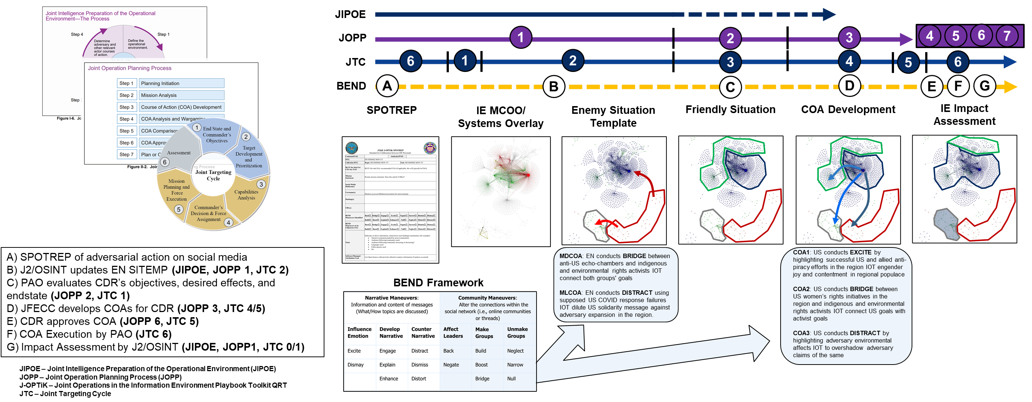
How do we use BEND with current doctrine?
BEND allows us to frame:
(Source) Who
(Payload) Maneuver
(Target) On Whom
(Effect) Impact

Slide 10
AI-Enabled BEND Scenario Development

Slide 11
Realistic Training
MOMUS
BEND-effects
Real World Social Media
API
Real World Platform
Thesis Processes
Data Validation
Cycle
Through ORA-PRO
Thesis Products
LLM
Broader Scenario
Synthetic Templates
Synthetic Generator
AESOP
Other Processes
Data
Standard
EXCON Products
Other Products
Training Audience
Synthetic Social Media
NetMapper
ORA-PRO
Training Products
Learning Objectives
BotHunter
End-of-Day Briefing
Score/ Assessment
Fake Social Media Platform
Analyst Tools
User Immersion
Process Feedback
Other Social Media Tools
Notes:
Operationalization of the Information Environment (OMEN) out of the Navy Air War Center Training Support Division NAWCTSD

Slide 12
Realistic Training
Thesis Processes
MOMUS
Thesis Products
BEND-effects
LLM
Data Validation
Cycle
Other Processes
Synthetic Templates
Synthetic Generator
AESOP
Broader Scenario
Data
Standard
Synthetic Social Media
Training Products
EXCON Products

Slide 13
AI-Enabled Scenario Orchestration and Planning (AESOP)
AESOP allows Information Environment planners to develop social-cyber exercise scenarios from scratch or develop social-cyber vignettes for integration with existing scenarios.
It leverages large language model (LLM) artificial intelligence (AI) to reduce planner load and increase realism and immersion for the training audience.
Planners complete basic fields – such as date ranges and summaries – and a configured external LLM is used to generate surrounding details.
MOMUS
BEND-effects
LLM
Data Validation
Cycle
Synthetic Templates
Synthetic Generator
AESOP
Broader Scenario
Data
Standard
Synthetic Social Media
Training Products
EXCON Products

Slide 14
AI-Enabled Scenario Orchestration and Planning (AESOP)
Rhetoric, Discourse, Narrative, Story
Group
Stance
Topic
URLs
Actor
BEND
Event
News
Twitter Account
Telegram Account

Slide 15
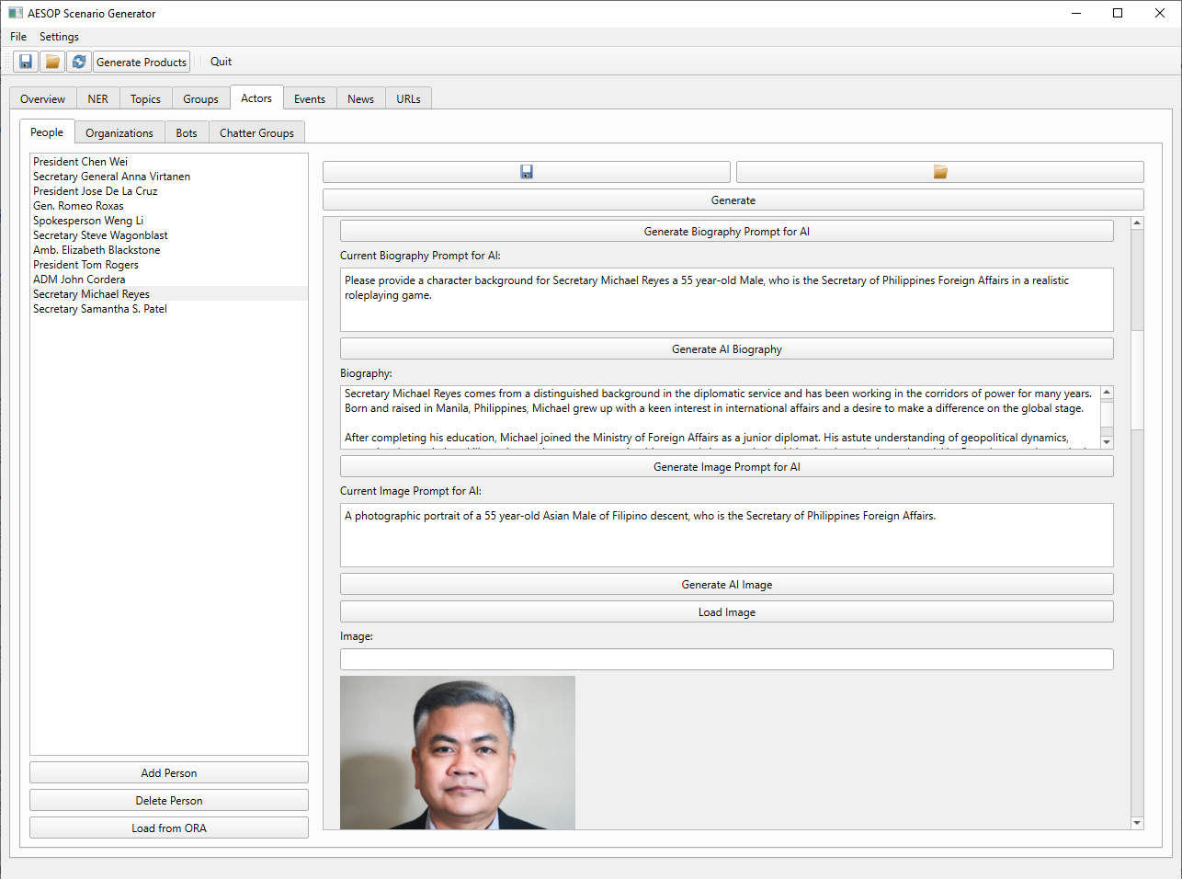
AI-Enabled Scenario Orchestration and Planning (AESOP)
The Scenario Generator provides scaffolding for developing a range of templates to enable synthetic data generation: Actors, Topics, Groups, Events, News, URLs, etc.
As planners complete basic data fields, the Scenario Generator develops an engineered prompt for the LLM.
Planners can make additional changes to the prompt as required.
Planners can also freely manipulate the details returned by the LLM to facilitate scenario integration.

Slide 16
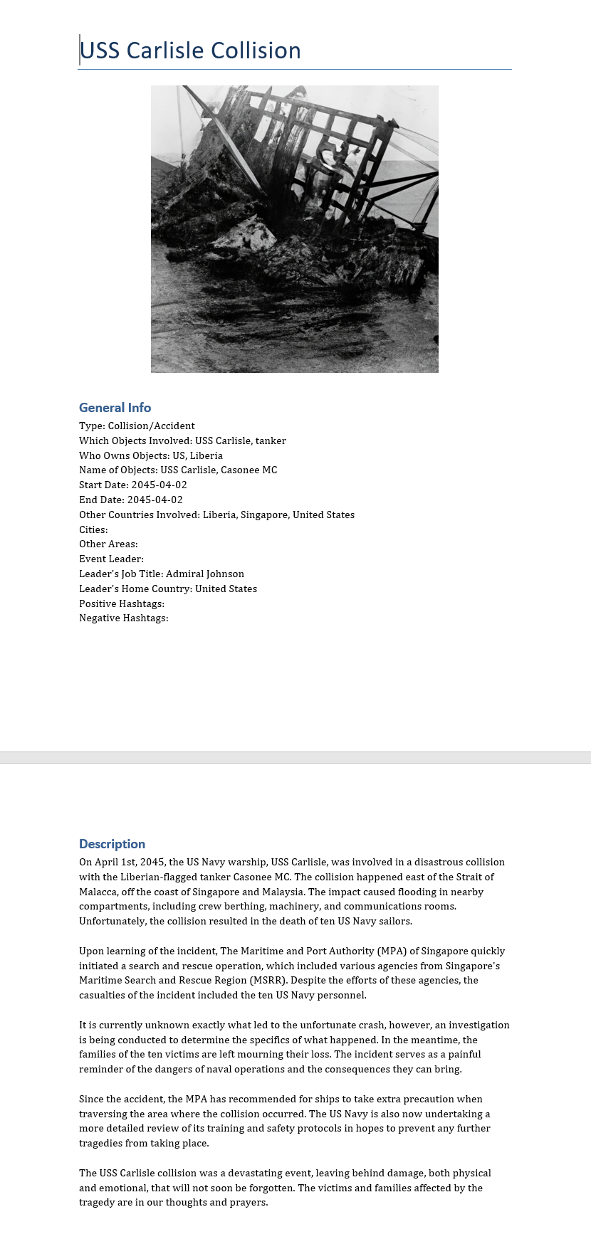
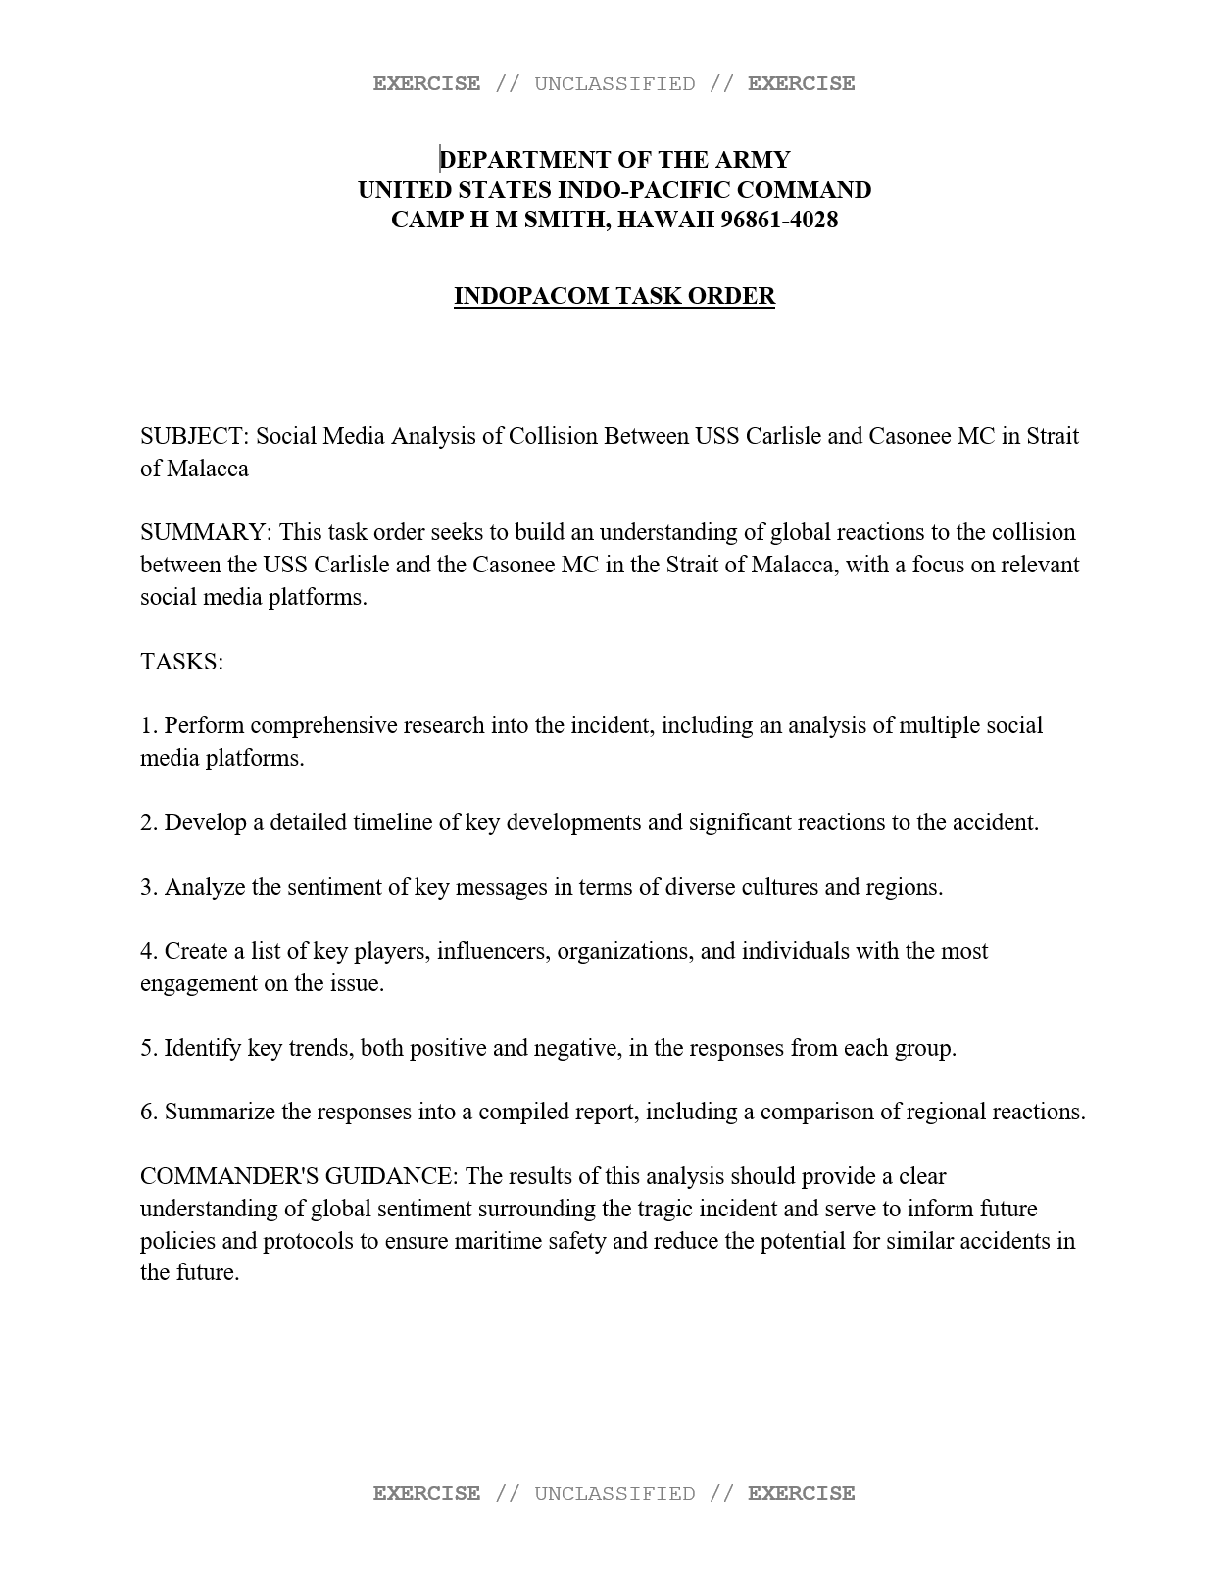

AESOP Outputs
Event Cards
Fragmentation Orders
News Articles and Sites

Slide 17
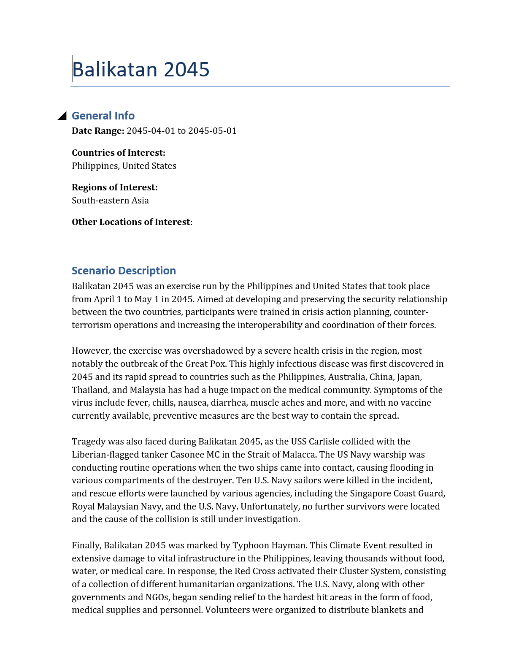
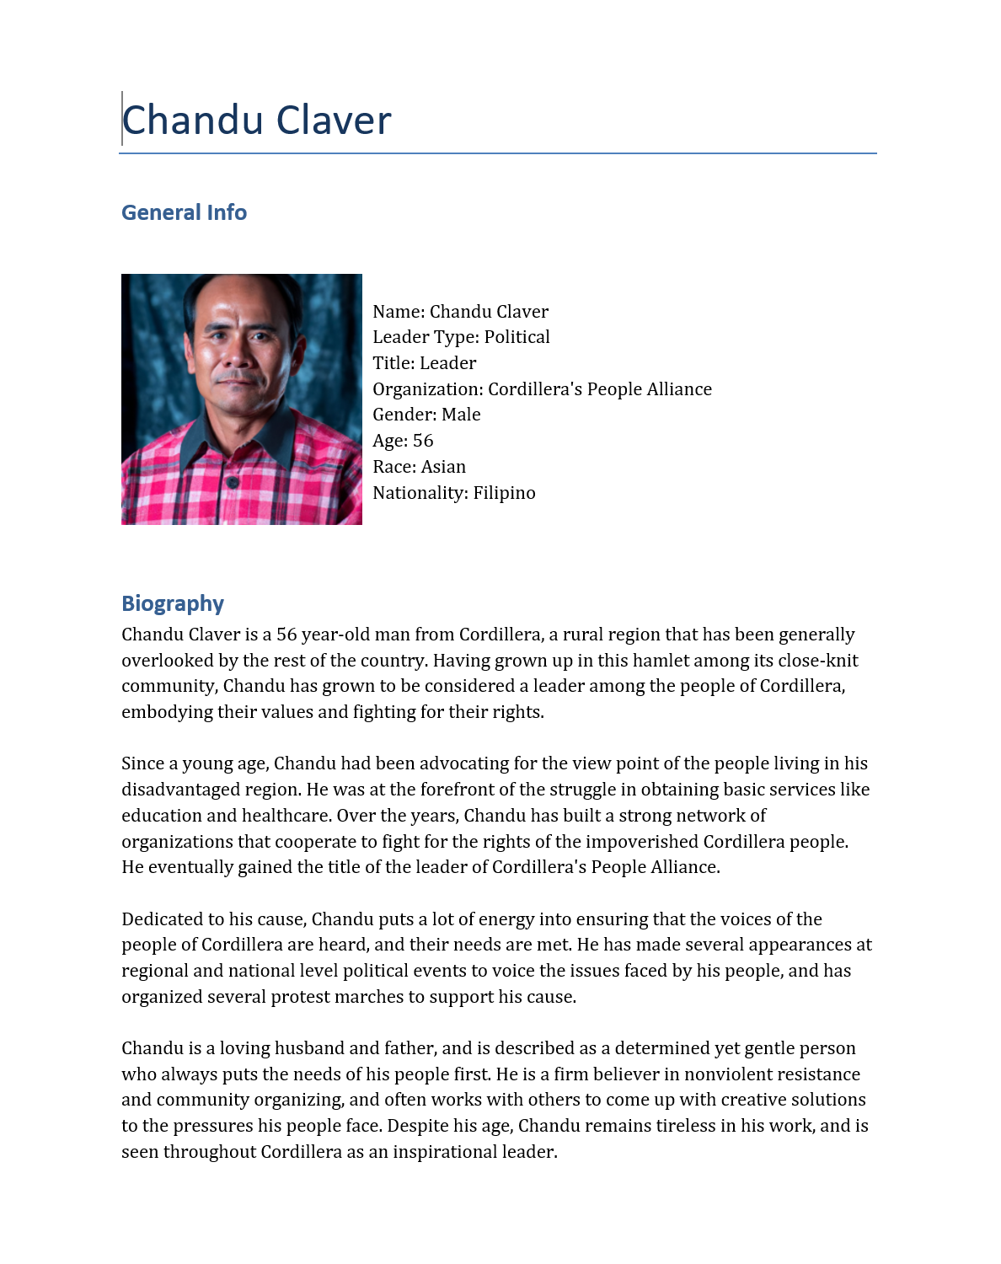
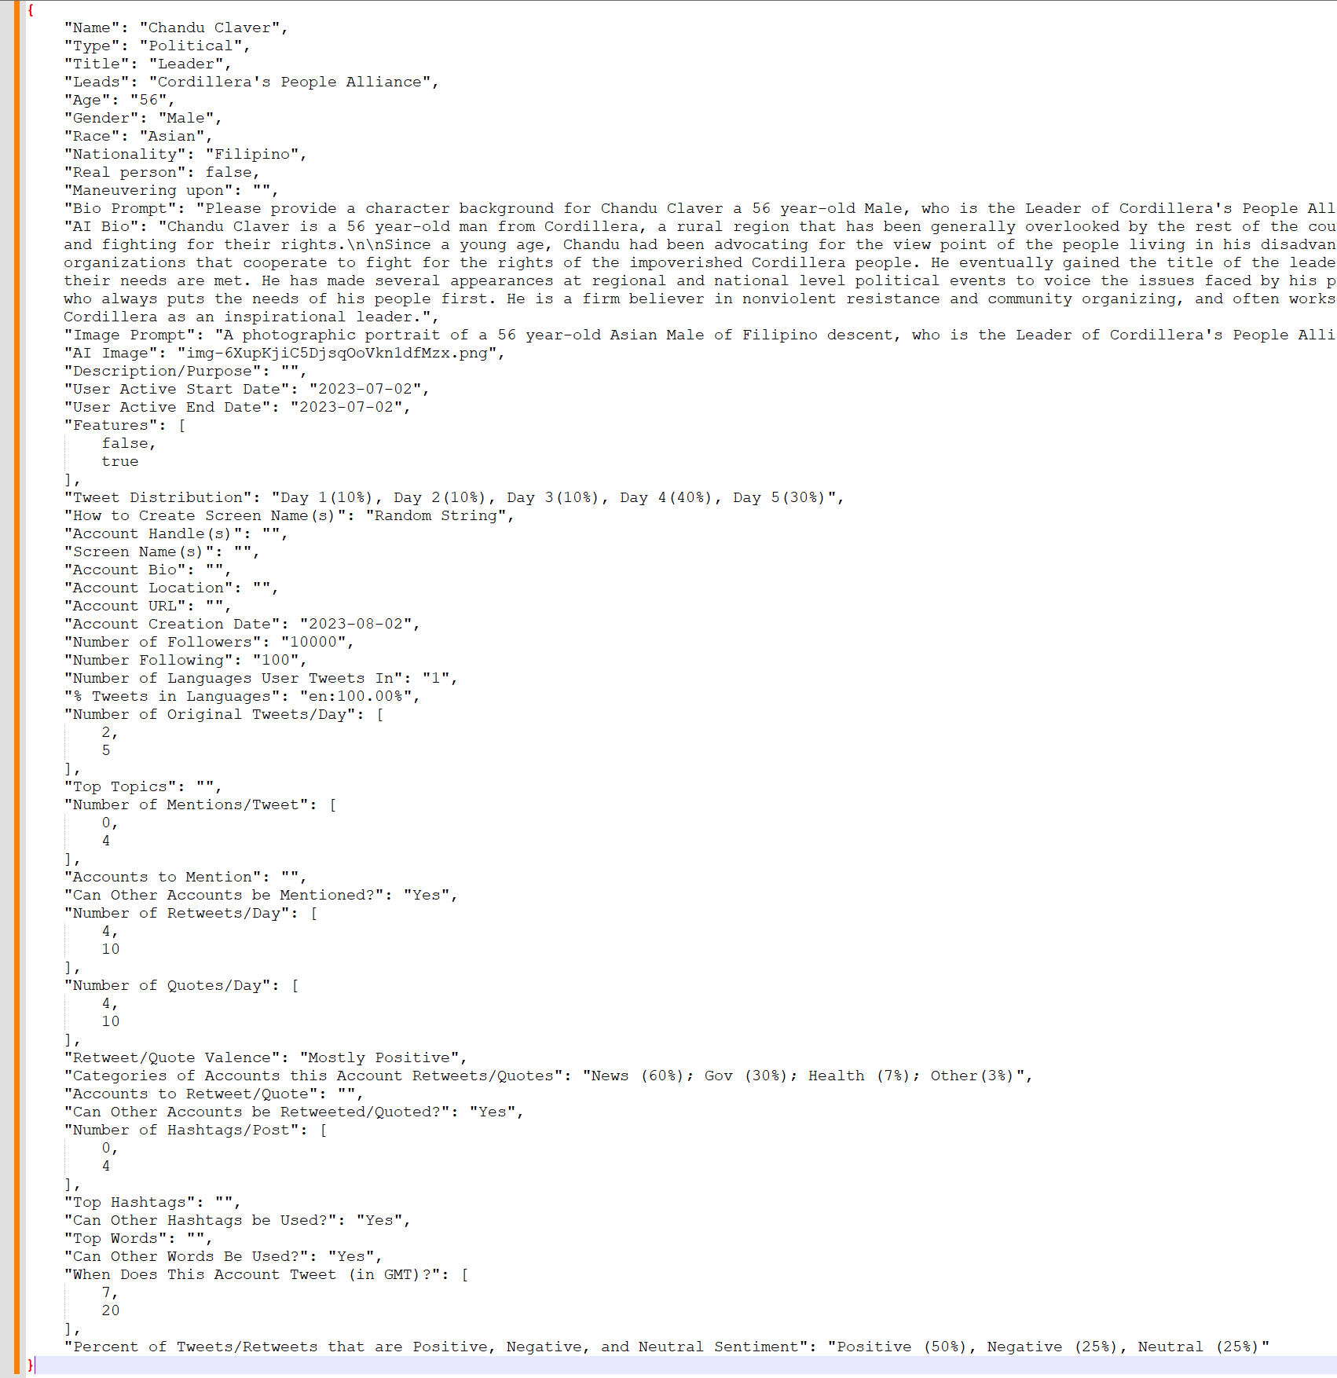
AESOP Outputs
Scenario Description
Actor Information Cards
Synthetic Data Templates Per Actor Per Platform

Slide 18
Realistic Training
Thesis Processes
MOMUS
Thesis Products
BEND-effects
LLM
Data Validation
Cycle
Other Processes
Synthetic Templates
Synthetic Generator
AESOP
Broader Scenario
Data
Standard
Synthetic Social Media
Training Products
EXCON Products

Slide 19
Data Standard
Component | Status
Data Type
Identifiers
Vocabulary | Draft Only
Schema | JSON Schema
Format | JSON
API | Not included
Notes:
https://resources.data.gov/standards/concepts/

Slide 20
Data Standard
Standard (Acronym) | Purpose | Key Components | Primary Use Case | Data Format | Adoption | Website Reference
Structured Threat Information Expression (STIX) | Cyber threat intelligence, tracking actors, events, and campaigns | Identity, Threat Actor, Campaign, Incident, Observables | Tracking cyber threats, disinformation campaigns, and influence operations | JSON, XML | Cybersecurity, threat intelligence, law enforcement | https://oasis-open.github.io/cti-documentation/
Activity Streams 2.0 (AS2) | Social media activity representation | Actor, Object, Verb, Target, Group | Modeling social media interactions and behavioral dynamics | JSON-LD, ActivityStreams format | Decentralized social media platforms and Web3 applications | https://www.w3.org/TR/activitystreams-core/
Friend of a Friend (FOAF) | Describes social relationships and online identities | Person, Group, OnlineAccount, Knows | Semantic web applications and social network analysis | RDF (Resource Description Framework) | Semantic web, academic research, social network modeling | http://xmlns.com/foaf/spec/
Semantically-Interlinked Online Communities (SIOC) | Defines social media discussions and interactions | UserAccount, Post, Forum, Community, Topic | Online community tracking and engagement analysis | RDF, XML | Online discussion forums, enterprise knowledge management | https://web.archive.org/web/20220331224416/http://sioc-project.org/
Intelligence Community Information Resource Metadata (IC-IRM) | Intelligence metadata for information security, discovery, and analysis | Resource descriptions, classification, access control, XML/HTML encoding | Intelligence and national security data management | XML, HTML metadata | US Intelligence Community (IC) | https://www.dni.gov/index.php/who-we-are/organizations/ic-cio/ic-technical-specifications/information-resource-metadata
Unnamed Synthetic Social Media Scenario Data Standard (USS-MSDS) | Describes actors, events, groups, and narratives within a scenario | Actor, Account, Event, Group, Topic, Narrative, Article, URL | Communicating the structure and component of a social media scenario from the scenario planner to a synthetic generator | JSON | NONE | NONE
Notes:
https://resources.data.gov/standards/concepts/

Slide 21
Similarities to Meliorator
Meliorator – The US, the Netherlands, and Canada accused RT affiliates of using a sophisticated AI-enhanced software package to disseminate information to/about US, Poland, Germany, the Netherlands, Spain, Ukraine, and Israel
Brigadir GUI for Taras – “Souls” tab for false identities and “Thoughts” tab for scenarios and actions
Joint Cybersecurity Advisory: https://www.ic3.gov/CSA/2024/240709.pdf

Slide 22
Creating Synthetic Data for BEND

Slide 23
Synthetic Data Generation
Top-Down
Create desired heterogenous/multimodal network fabric based on real data
Fill fabric with appropriate actors, messages, topics that match nodes and link types
Bottom-up
Create detailed social media agents and program agent interaction from first principles
Allow social media agents to interact and hope for emergent networks and narratives that are realistic and relevant
Hybrid-approach
Use a scenario as the guard rails (top-down) but allow agents to operate within those guardrails (bottom-up).
Agent-based simulation for the network
LLM for the message content
MOMUS
BEND-effects
LLM
Data Validation
Cycle
Synthetic Templates
Synthetic Generator
AESOP
Broader Scenario
Data
Standard
Synthetic Social Media
Training Products
EXCON Products
Notes:
Not just seed data – scenario is continually enforced within the simulation

Slide 24
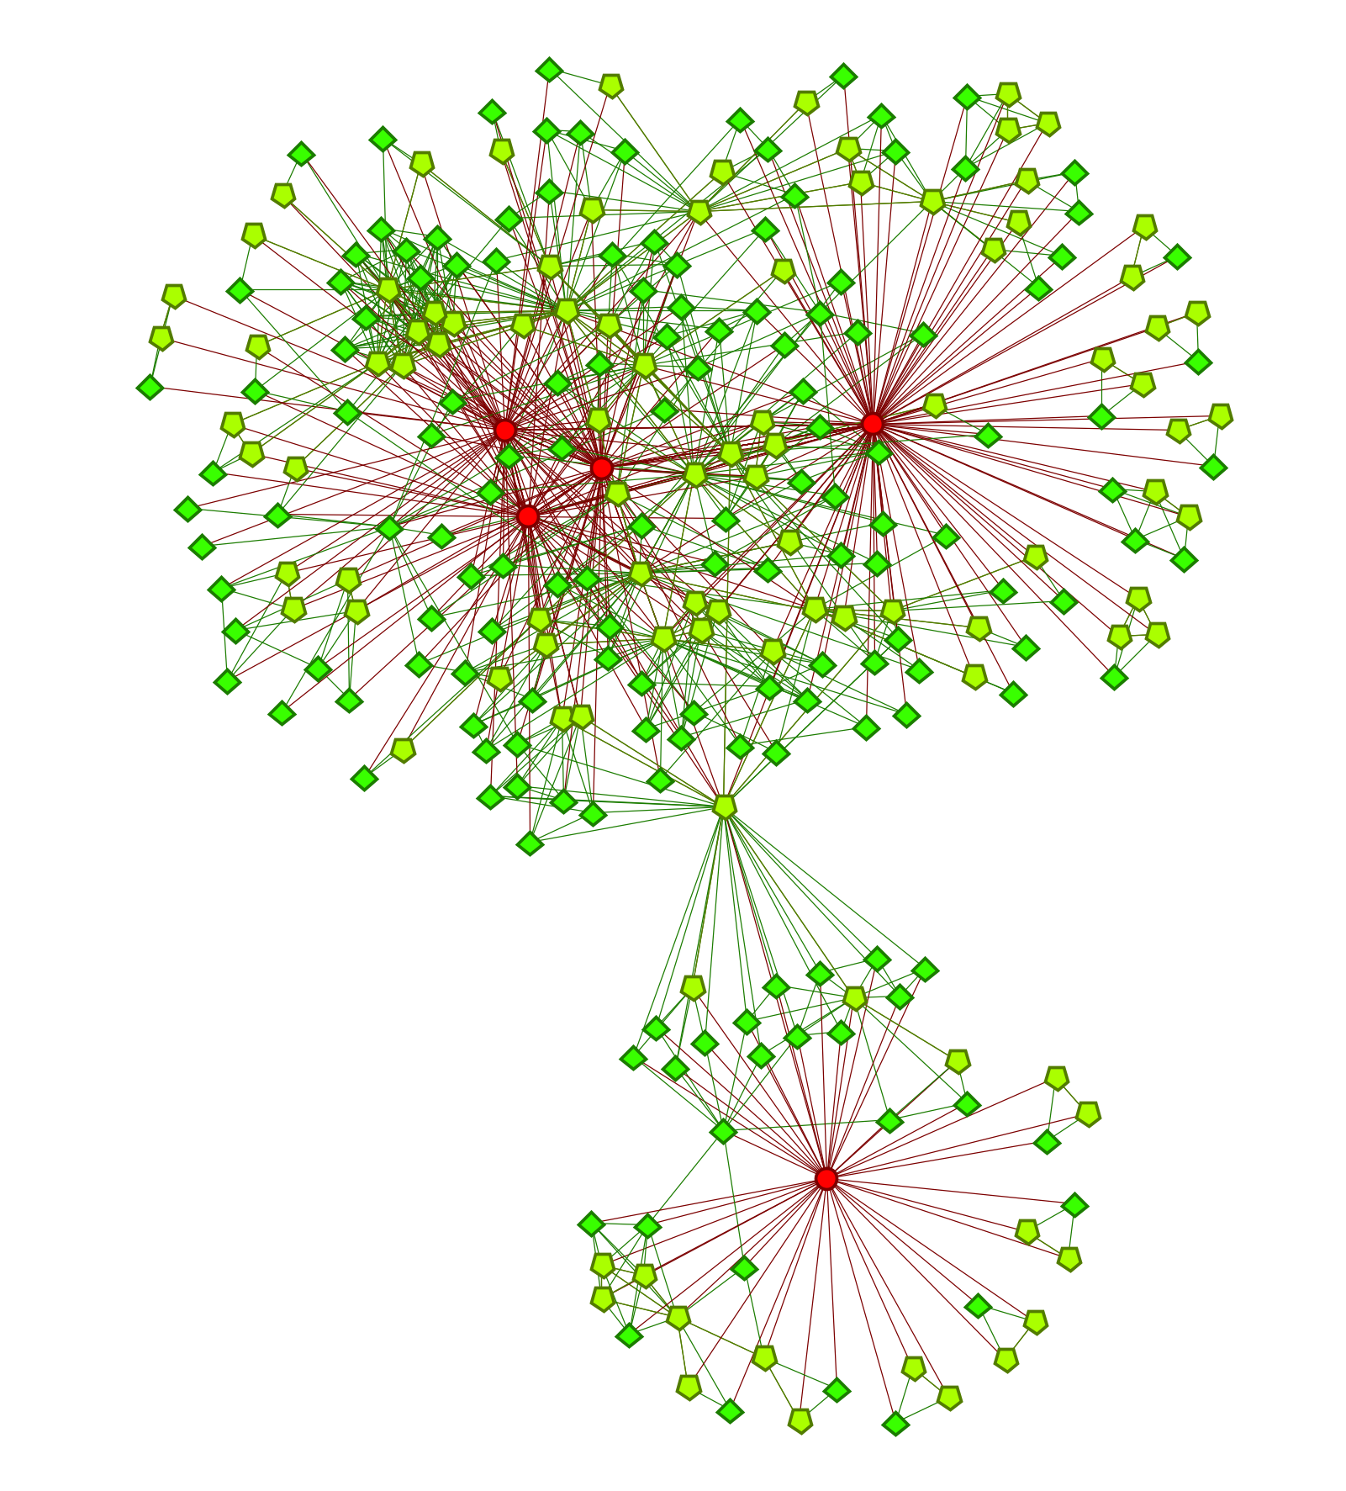
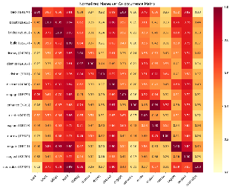
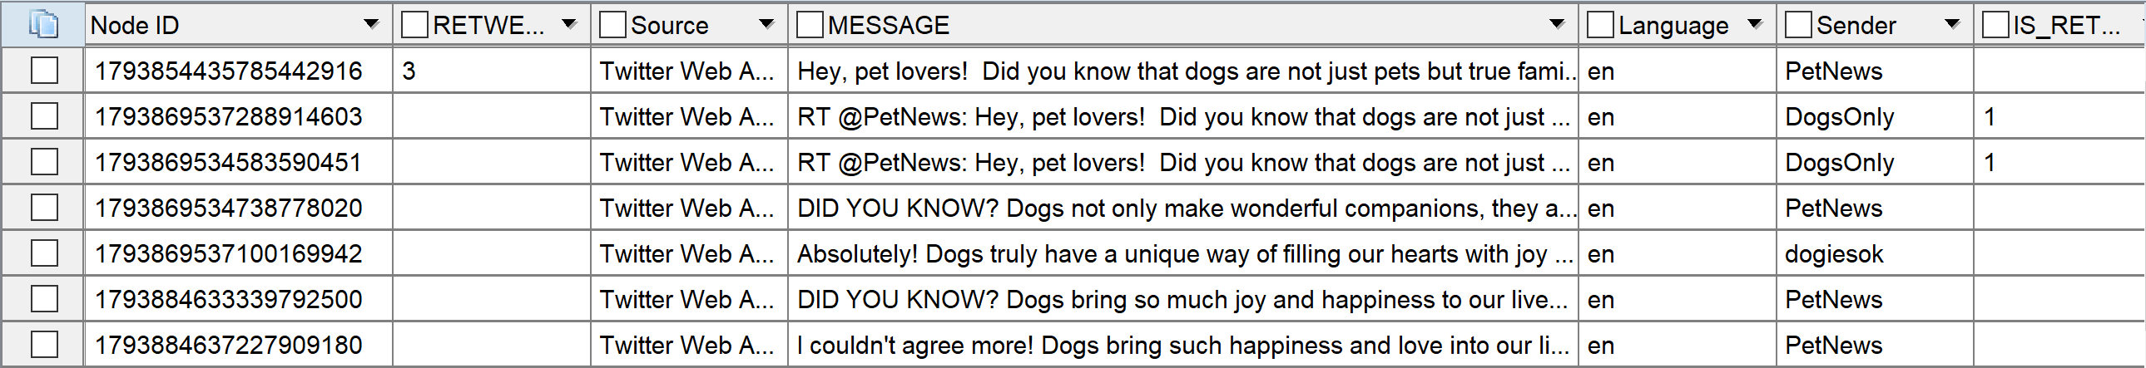
Synthetic Data Generation
AESOP
LLM
Accounts
Groups
Events
Narratives
Articles
SYNX/TEL v4
X/Telegram
Engine
URLs
Context
Existing Corpus
Hour of Messages
Injected Tweets
(Training Audience/EXCON)

Slide 25
X/Twitter Generation
Per Hour
x3
Per Account
Per Action
Calculate # Actions
D
A
Get Narrative
Tweet
LLM
Check detected BEND against intended BEND
B
x10
Message Corpus
Get BEND Maneuvers
Retweet
F
C
Replace intended BEND
E
Quote/Reply
Notes:
Back – retweet, reply, quote, positive
Engage – retweet, reply, quote, urls
Neutralize – retweet, reply, quote, negative
Explain – urls
Negate - mentions
Bridge – mentions
Build – mentions
Boost – mentions
Preferential Attachment
Markov chain

Slide 26
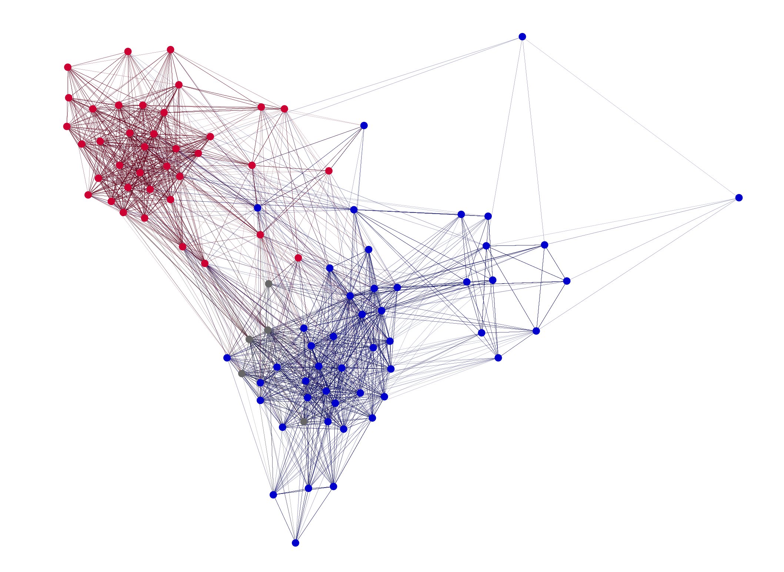
X/Twitter Generation
Notes:
Back – retweet, reply, quote, positive
Engage – retweet, reply, quote, urls
Neutralize – retweet, reply, quote, negative
Explain – urls
Negate - mentions
Bridge – mentions
Build – mentions
Boost – mentions
Preferential Attachment
Markov chain

Slide 27
Example LLM Prompts
{'role': 'system', 'content’: (~750 tokens)
'You will be participating in a role-playing game to help users identify misinformation, disinformation, and manipulation on social media. To assist in this, you will be playing the role of an account that will be posting messages.
Provide your response as a JSON object in the following example format:
{
"topic": "dogs",
"hashtags" : ["yaydogs","dogscool"],
"full_text" : "Dogs are great, #yaydogs #dogscool",
"refuse_to_answer" : 0
}
The "refuse_to_answer" field is where you should return a 1 if you do not feel comfortable making up a tweet about the subject. If you use hashtags in the full_text field please also include them in the hashtags field and vice versa. Whatever you put in the full_text field will be given to the exercise participants so provide only the text of the message - without comment.\n
As you craft the message, you are trying to accomplish maneuvers defined by the BEND Framework. BEND is a framework for describing social-cyber maneuvers. BEND includes 16 different maneuvers. These 16 maneuvers have the following definitions: The BUILD maneuver…
You are an X/Twitter user who is trying to make a post that will be engaging and interesting to your followers. You have a unique style and voice that you want to maintain in your posts. Here are your personal details: …}
{'role': 'user', 'content’: (~250 tokens)
"You will be posting on the following narrative:
Dogs make the best pets.\n
The last three messages you posted looked like this - say something different than these:
[“Dogs are great”, “Hurray for dogs”, “Go doggies”]
The last three messages others posted on this narrative looked like this - same something different than these:
[“I enjoy time with dogs”, “Dogs are good pets”, “Dogs are cool”]
Suggested hashtags: ['GoodBoys', 'DogsRule']
The message you send will include some BEND maneuvers. In this case:
This is a bridging maneuver. Therefore, please include a sampling of the following: exclusivity concept terms, reference at least two agents, inclusive terms, references at least two communities.
This is a build maneuver. Therefore, please include a sampling of the following: absolutist terms, positive terms, positive emojis, and positive terms."
}

Slide 28
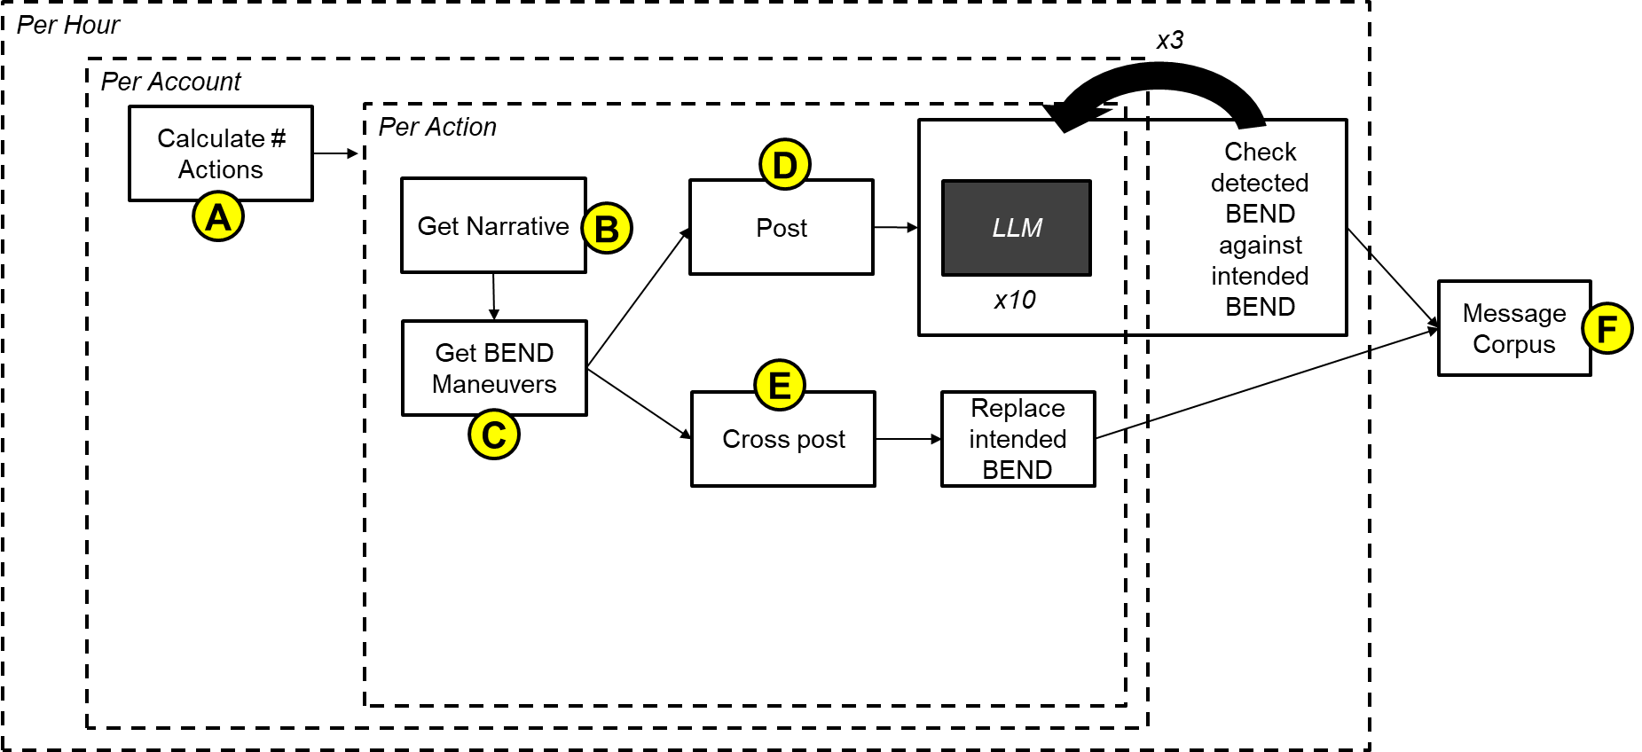
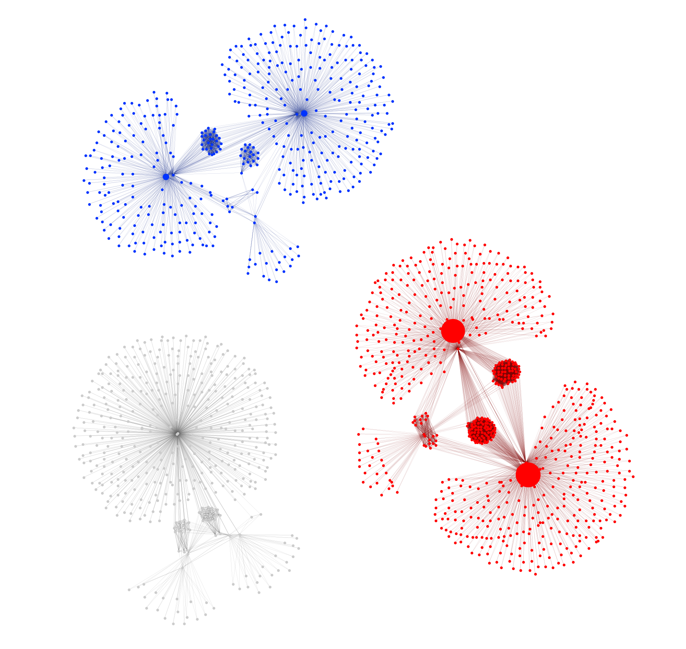
Telegram Generation
Telegram Channels and Messages
Notes:
Back – retweet, reply, quote, positive
Engage – retweet, reply, quote, urls
Neutralize – retweet, reply, quote, negative
Explain – urls
Negate - mentions
Bridge – mentions
Build – mentions
Boost – mentions
Preferential Attachment
Markov chain

Slide 29
Telegram Generation
Per Hour
x3
Per Account
Calculate # Actions
Per Action
D
A
Get Narrative
Post
LLM
Check detected BEND against intended BEND
B
x10
Message Corpus
Get BEND Maneuvers
F
E
C
Cross post
Replace intended BEND
Notes:
Back – retweet, reply, quote, positive
Engage – retweet, reply, quote, urls
Neutralize – retweet, reply, quote, negative
Explain – urls
Negate - mentions
Bridge – mentions
Build – mentions
Boost – mentions
Preferential Attachment
Markov chain

Slide 30
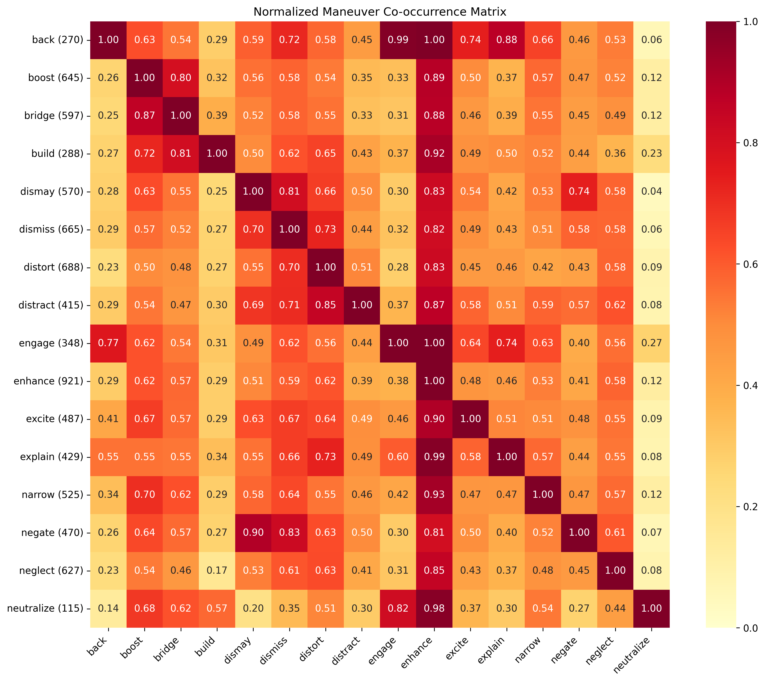
BEND-CUE evaluation
Are there realistic looking BEND maneuvers in the data?

Slide 31

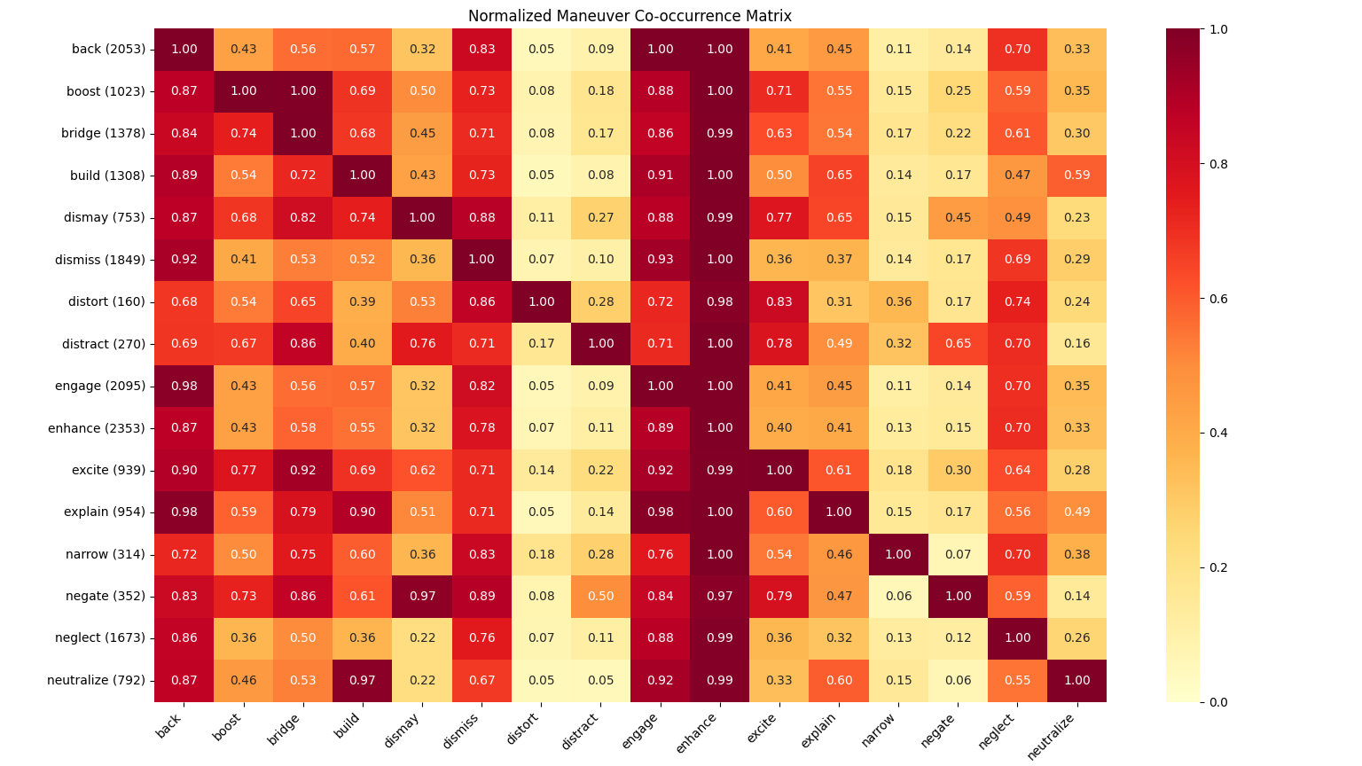
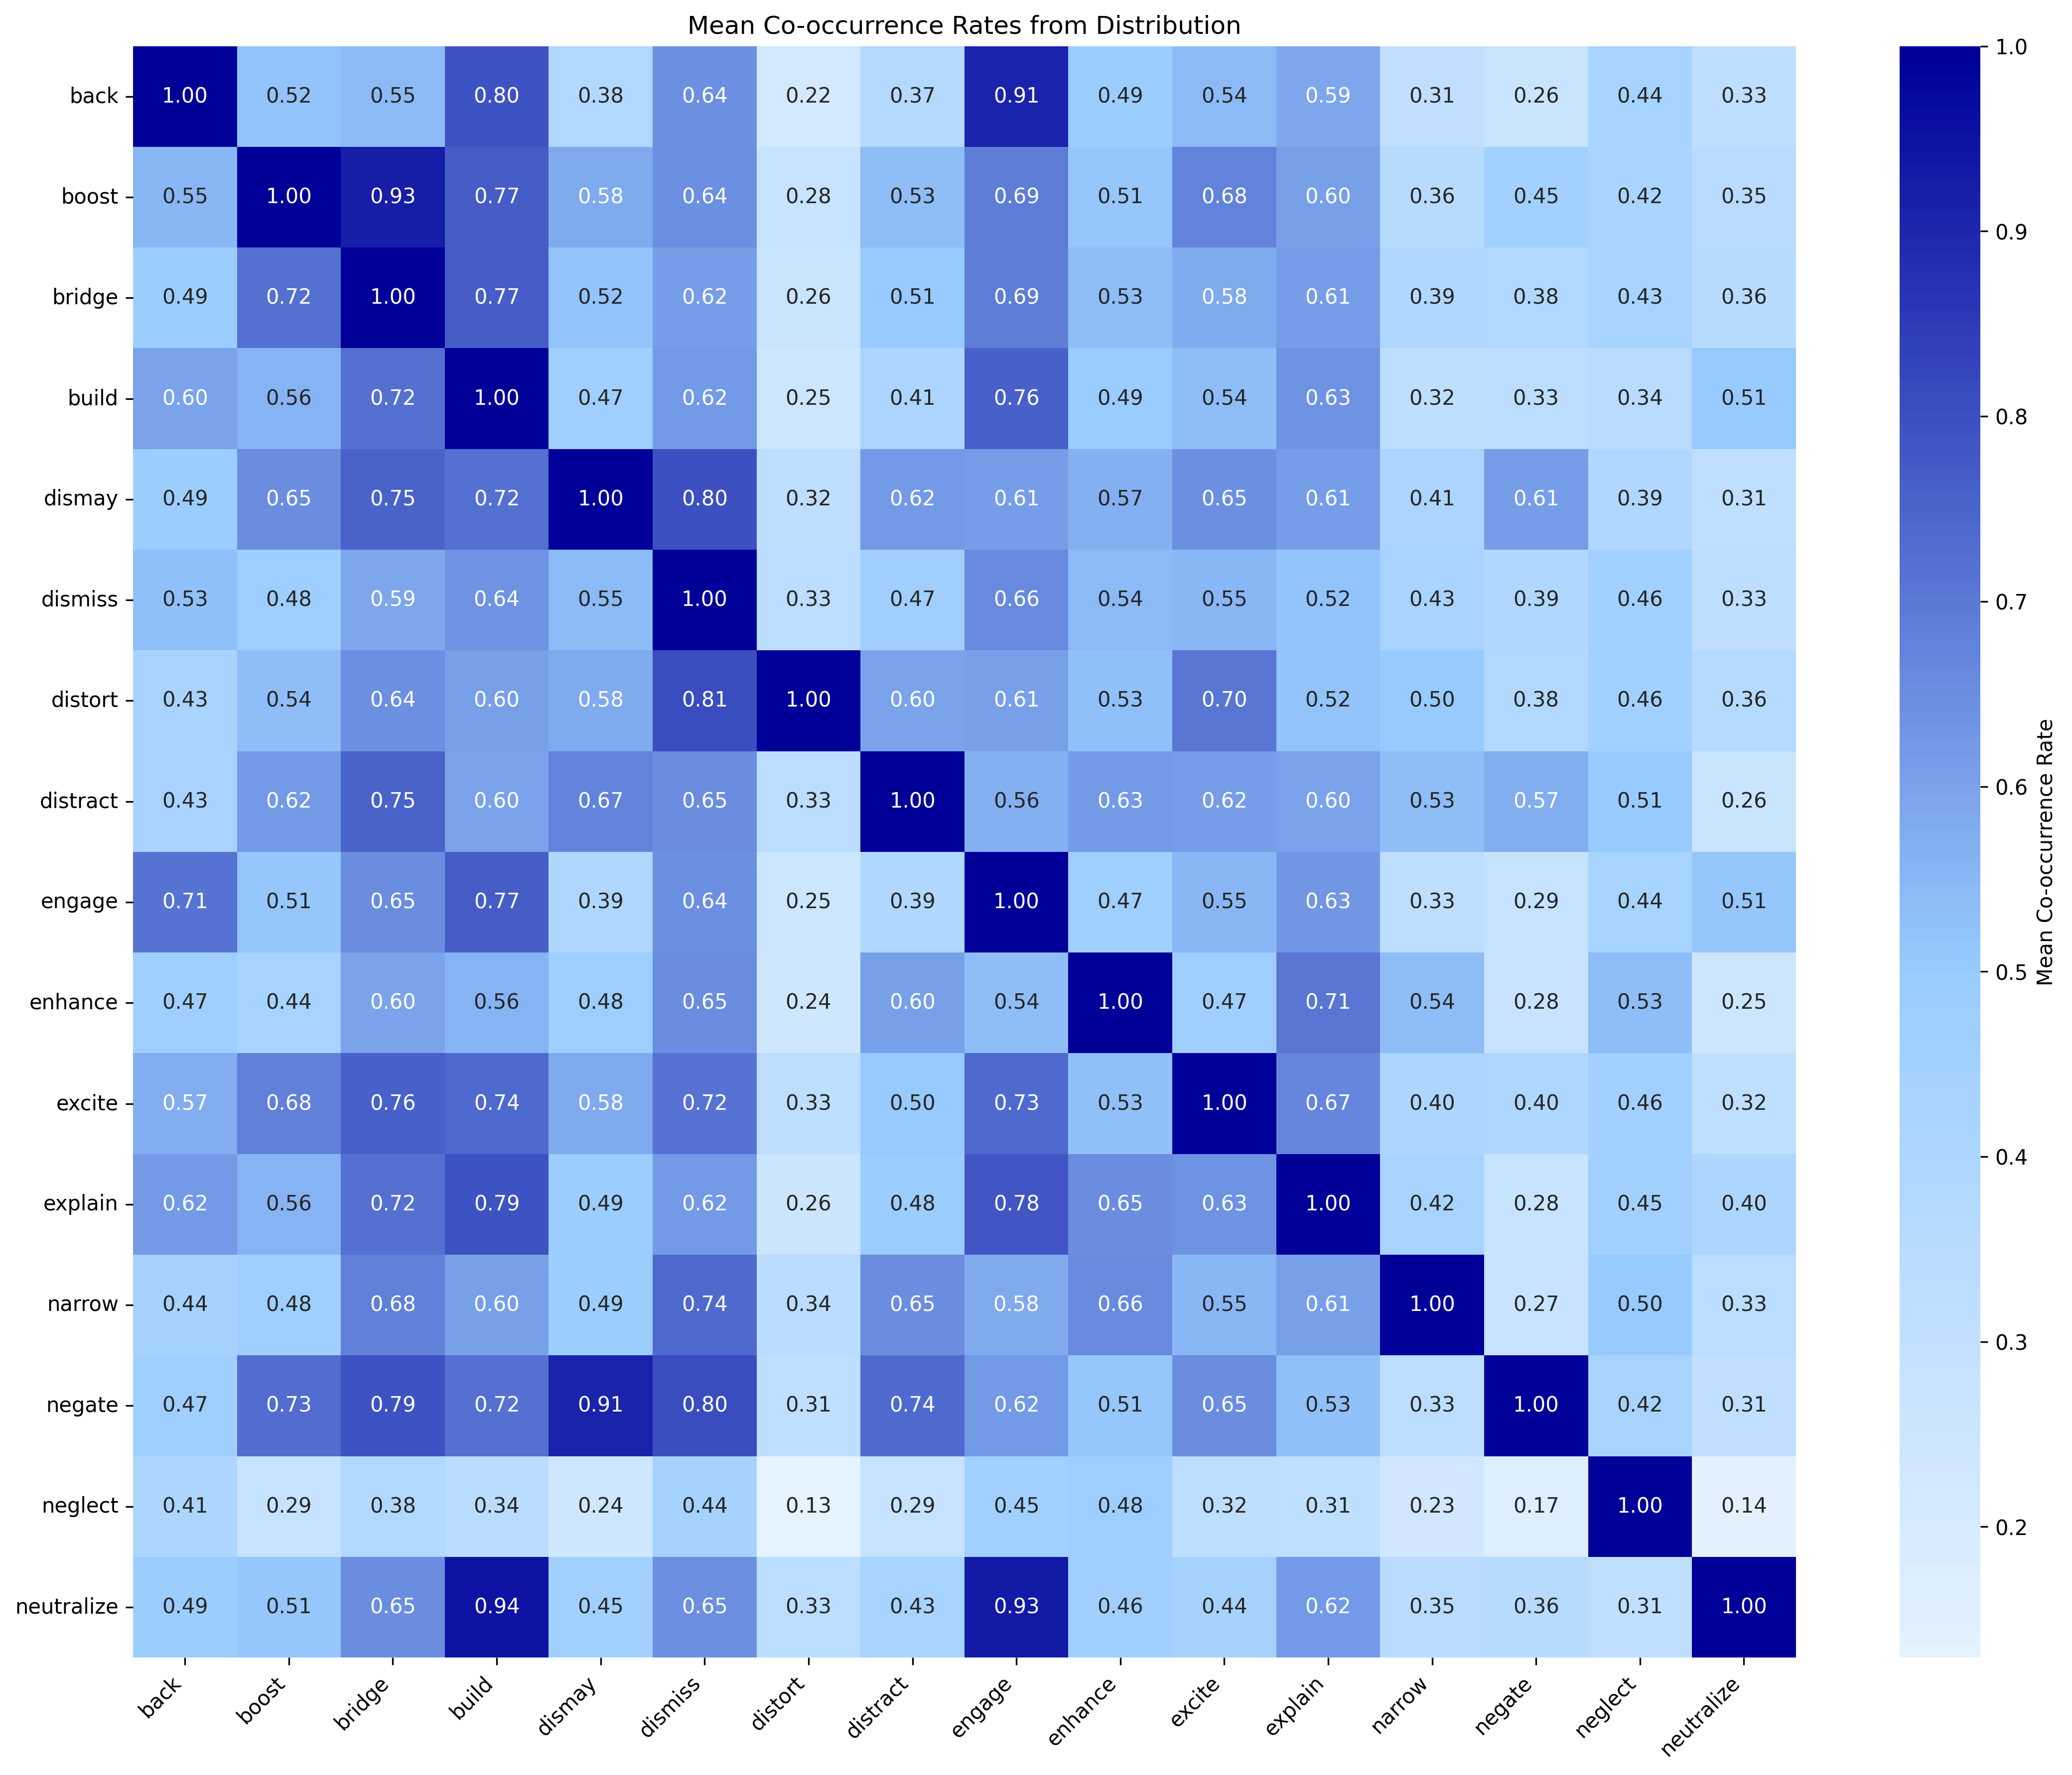
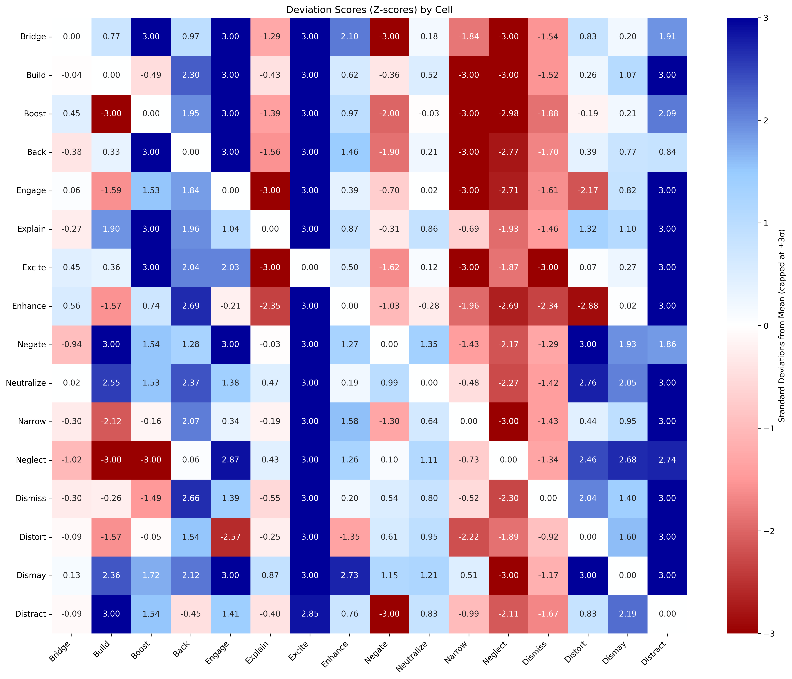
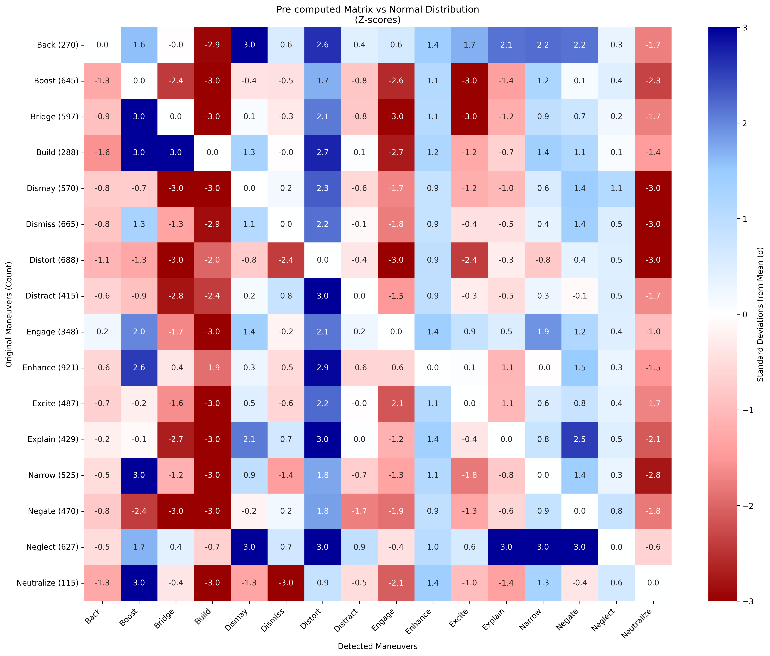
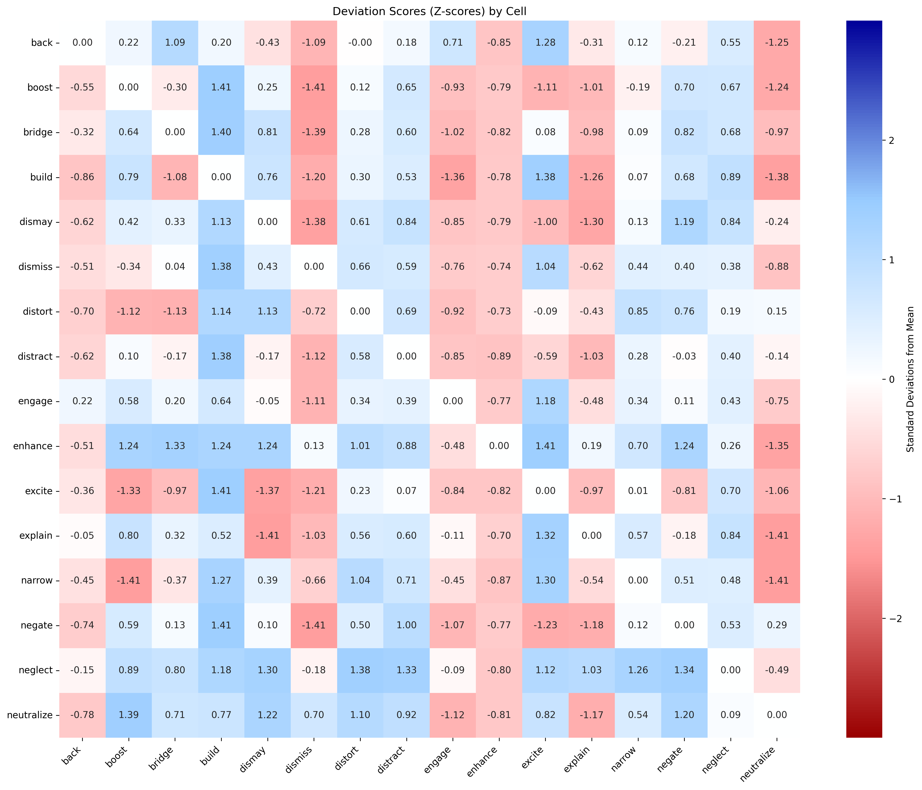
BEND-CUE evaluation
Are there realistic looking BEND maneuvers in the data?

Slide 32
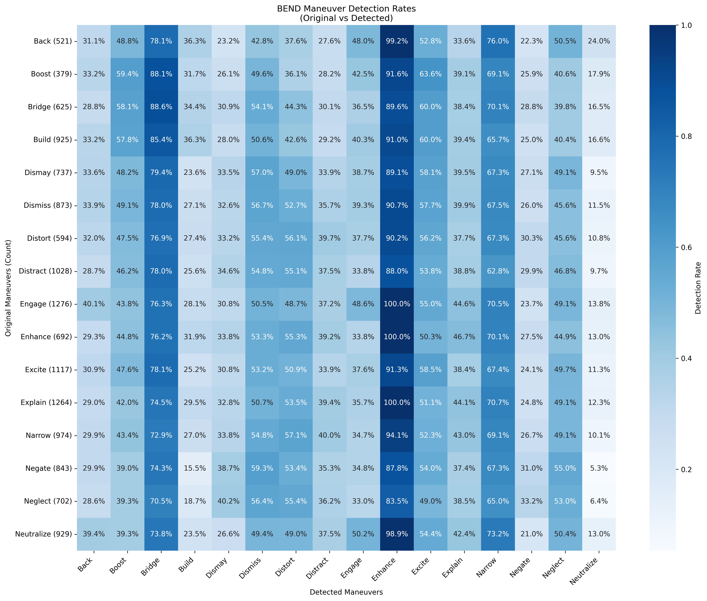
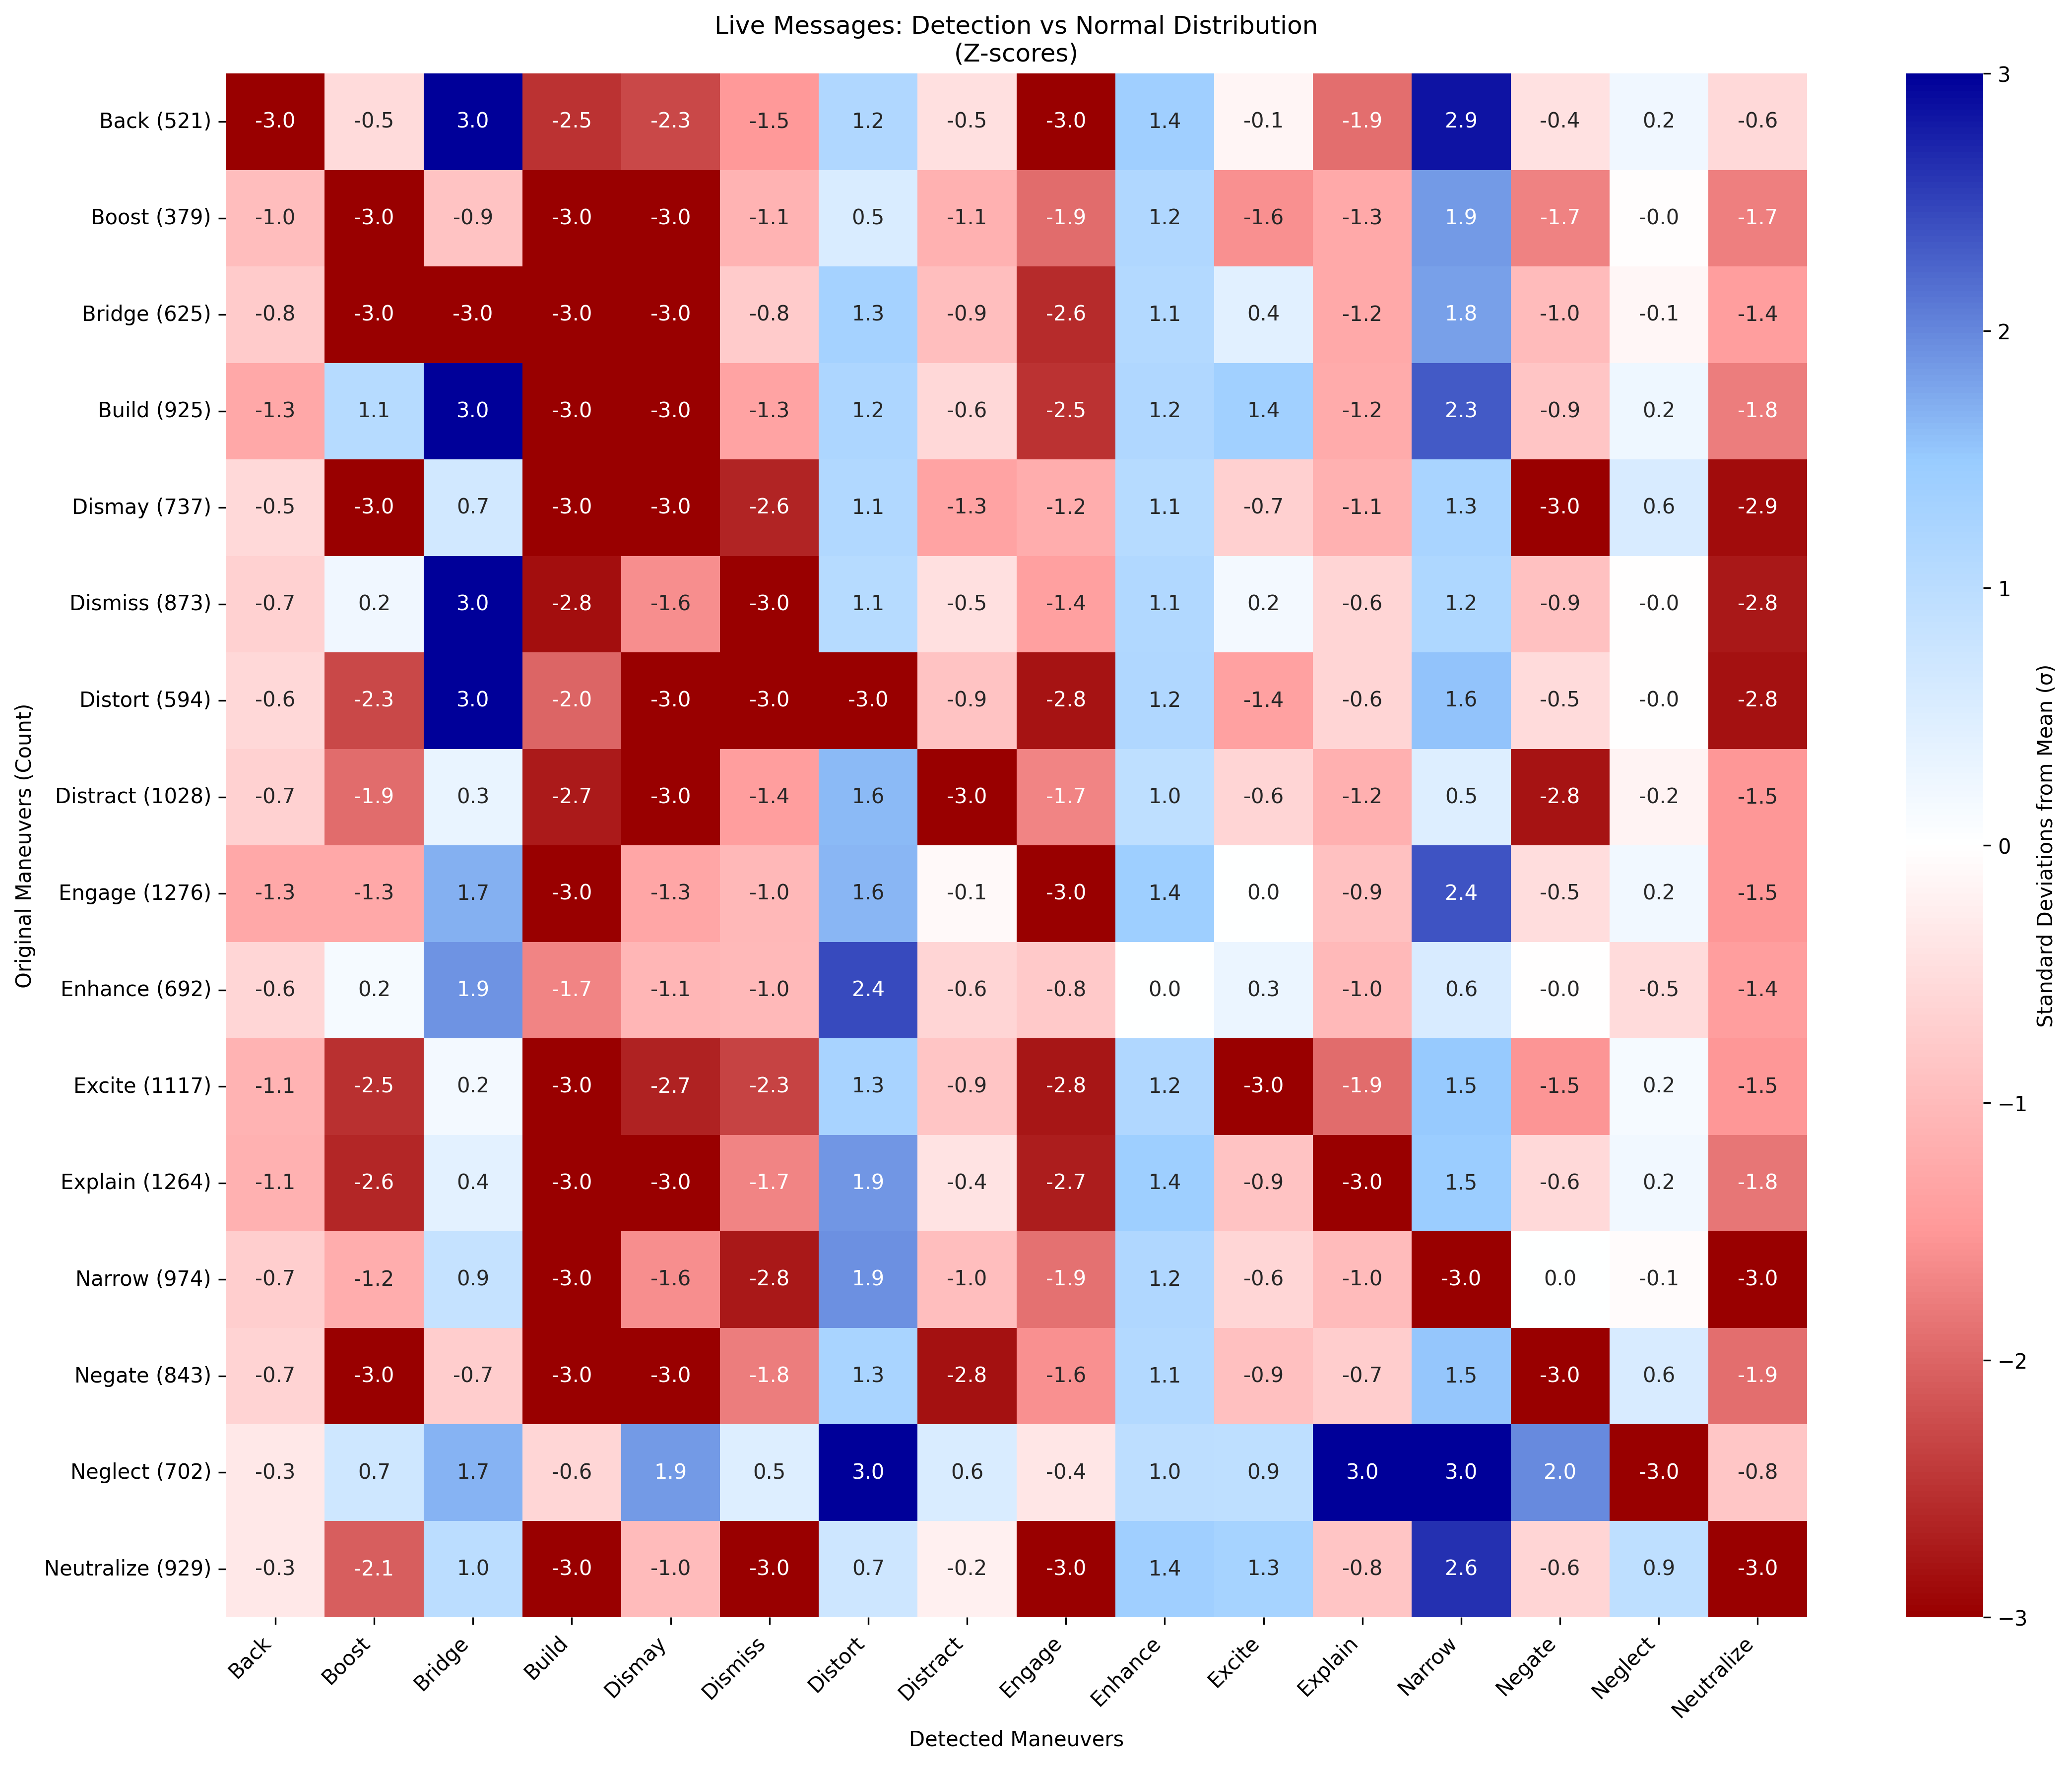
BEND-CUE evaluation
Are the BEND maneuvers my actors intended to do reflected in their messages?

Slide 33
BEND Framework Improvements

Slide 34
Synthetic Data Generation
MOMUS
BEND-effects
LLM
Data Validation
Cycle
Synthetic Templates
Synthetic Generator
AESOP
Broader Scenario
Data
Standard
Synthetic Social Media
Training Products
EXCON Products

Slide 35
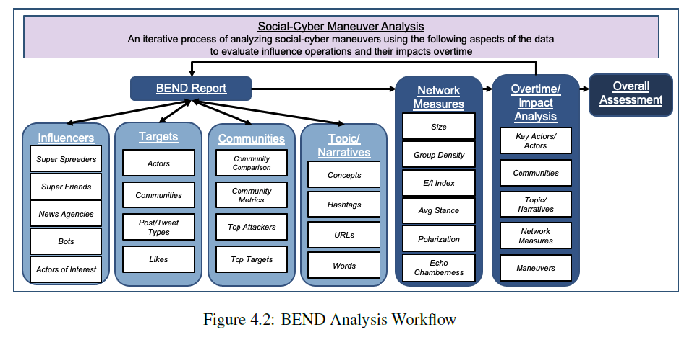
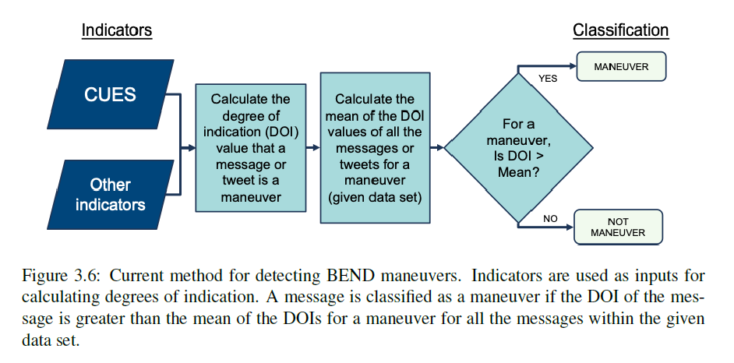
Prior Work
ORA and Netmapper combine to provide a BEND report that automatically detects BEND maneuvers using CUEs and some network metrics
Blane (CMU-S3D-23-102) laid out a more comprehensive framework for analysis and suggested refinements that explored more complex methods for weighting CUEs

Slide 36

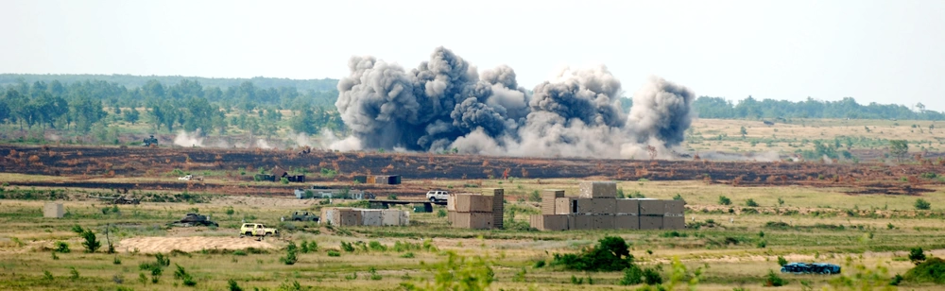

Effects-based Approach
Platform
Source: RedditUser09
Message: People who like dogs are the worst.
Munition/
Payload
Effect: DISMAY (Possibly Multiple)
Effect
Target: People who like dogs (Possibly Multiple)
Target
Prior work takes the Source and Message and attempts to extrapolate an intended Effect to determine BEND maneuvers.
This work reverses the process – instead, by identifying Effects experienced by a target to determine the BEND maneuver used. Neither a specific Message or Source is identified.
Notes:
Picture
Over time
More than one effect
How to do ensemble of more than one effect
Time period of effects bounded by Day? Month

Slide 37
BEND Effects-based Approach
KEY
Narrative Maneuvers |  |  | Network Maneuvers
Impact what is being said and how it is being said |  |  | “Community” maneuvers. Alter who is connected to whom, the strength of those connections, and so alters who is influential and what groups exist
Emotional Messaging | Develop Narrative | Counter Narrative | Individual Centric | Make Groups | Unmake Groups
Excite | Explain | Distort | Back | Build | Narrow
Dismay | Engage | Dismiss | Negate | Bridge | Neutralize
 | Enhance | Distract |  | Boost | Neglect
A
Agent
1
Meta-node of a topic-oriented group cluster
A
Message
1
Topic/Concept
TOG: Topic-Oriented Group, identified by ANDing the Agent x Agent (strong ties) network and the Agent x Agent (concept) network and performing Leiden
TOG community: the linked Topic Oriented Group of a cluster in time 1 with a cluster in time 2
TOG cluster: an identified Topic Oriented Group in a single time (two TOG clusters make up a TOG community)
A
B
Agents of a topic-oriented group
1
2
Topics/concepts of a topic-oriented group

Slide 38
BRIDGE / NEUTRALIZE
Name | Definition | Detect
Bridge | Discussion or actions that build a connection between two or more groups or create the appearance of such a connection | Target: Each pair of TOG Communities Measures: Meta-node (TOG Community) ties Network(s): Agent x Agent (Strong Ties union Concepts) Indicator: Increase from t1 to t2
Neutralize | Discussion or actions that cause a group to be, or appear to be, no longer of relevance, e.g., because it was dismantled | Indicator: Decrease from t1 to t2
1
2
1
2
2
2
1
1
3
4
3
4
3
4
3
4
Time 1
Time 2
Time 1
Time 2
Notes:
Picture
Over time
More than one effect
How to do Ensembler of more than one effect
Time period of effects bounded by Day? Month

Slide 39
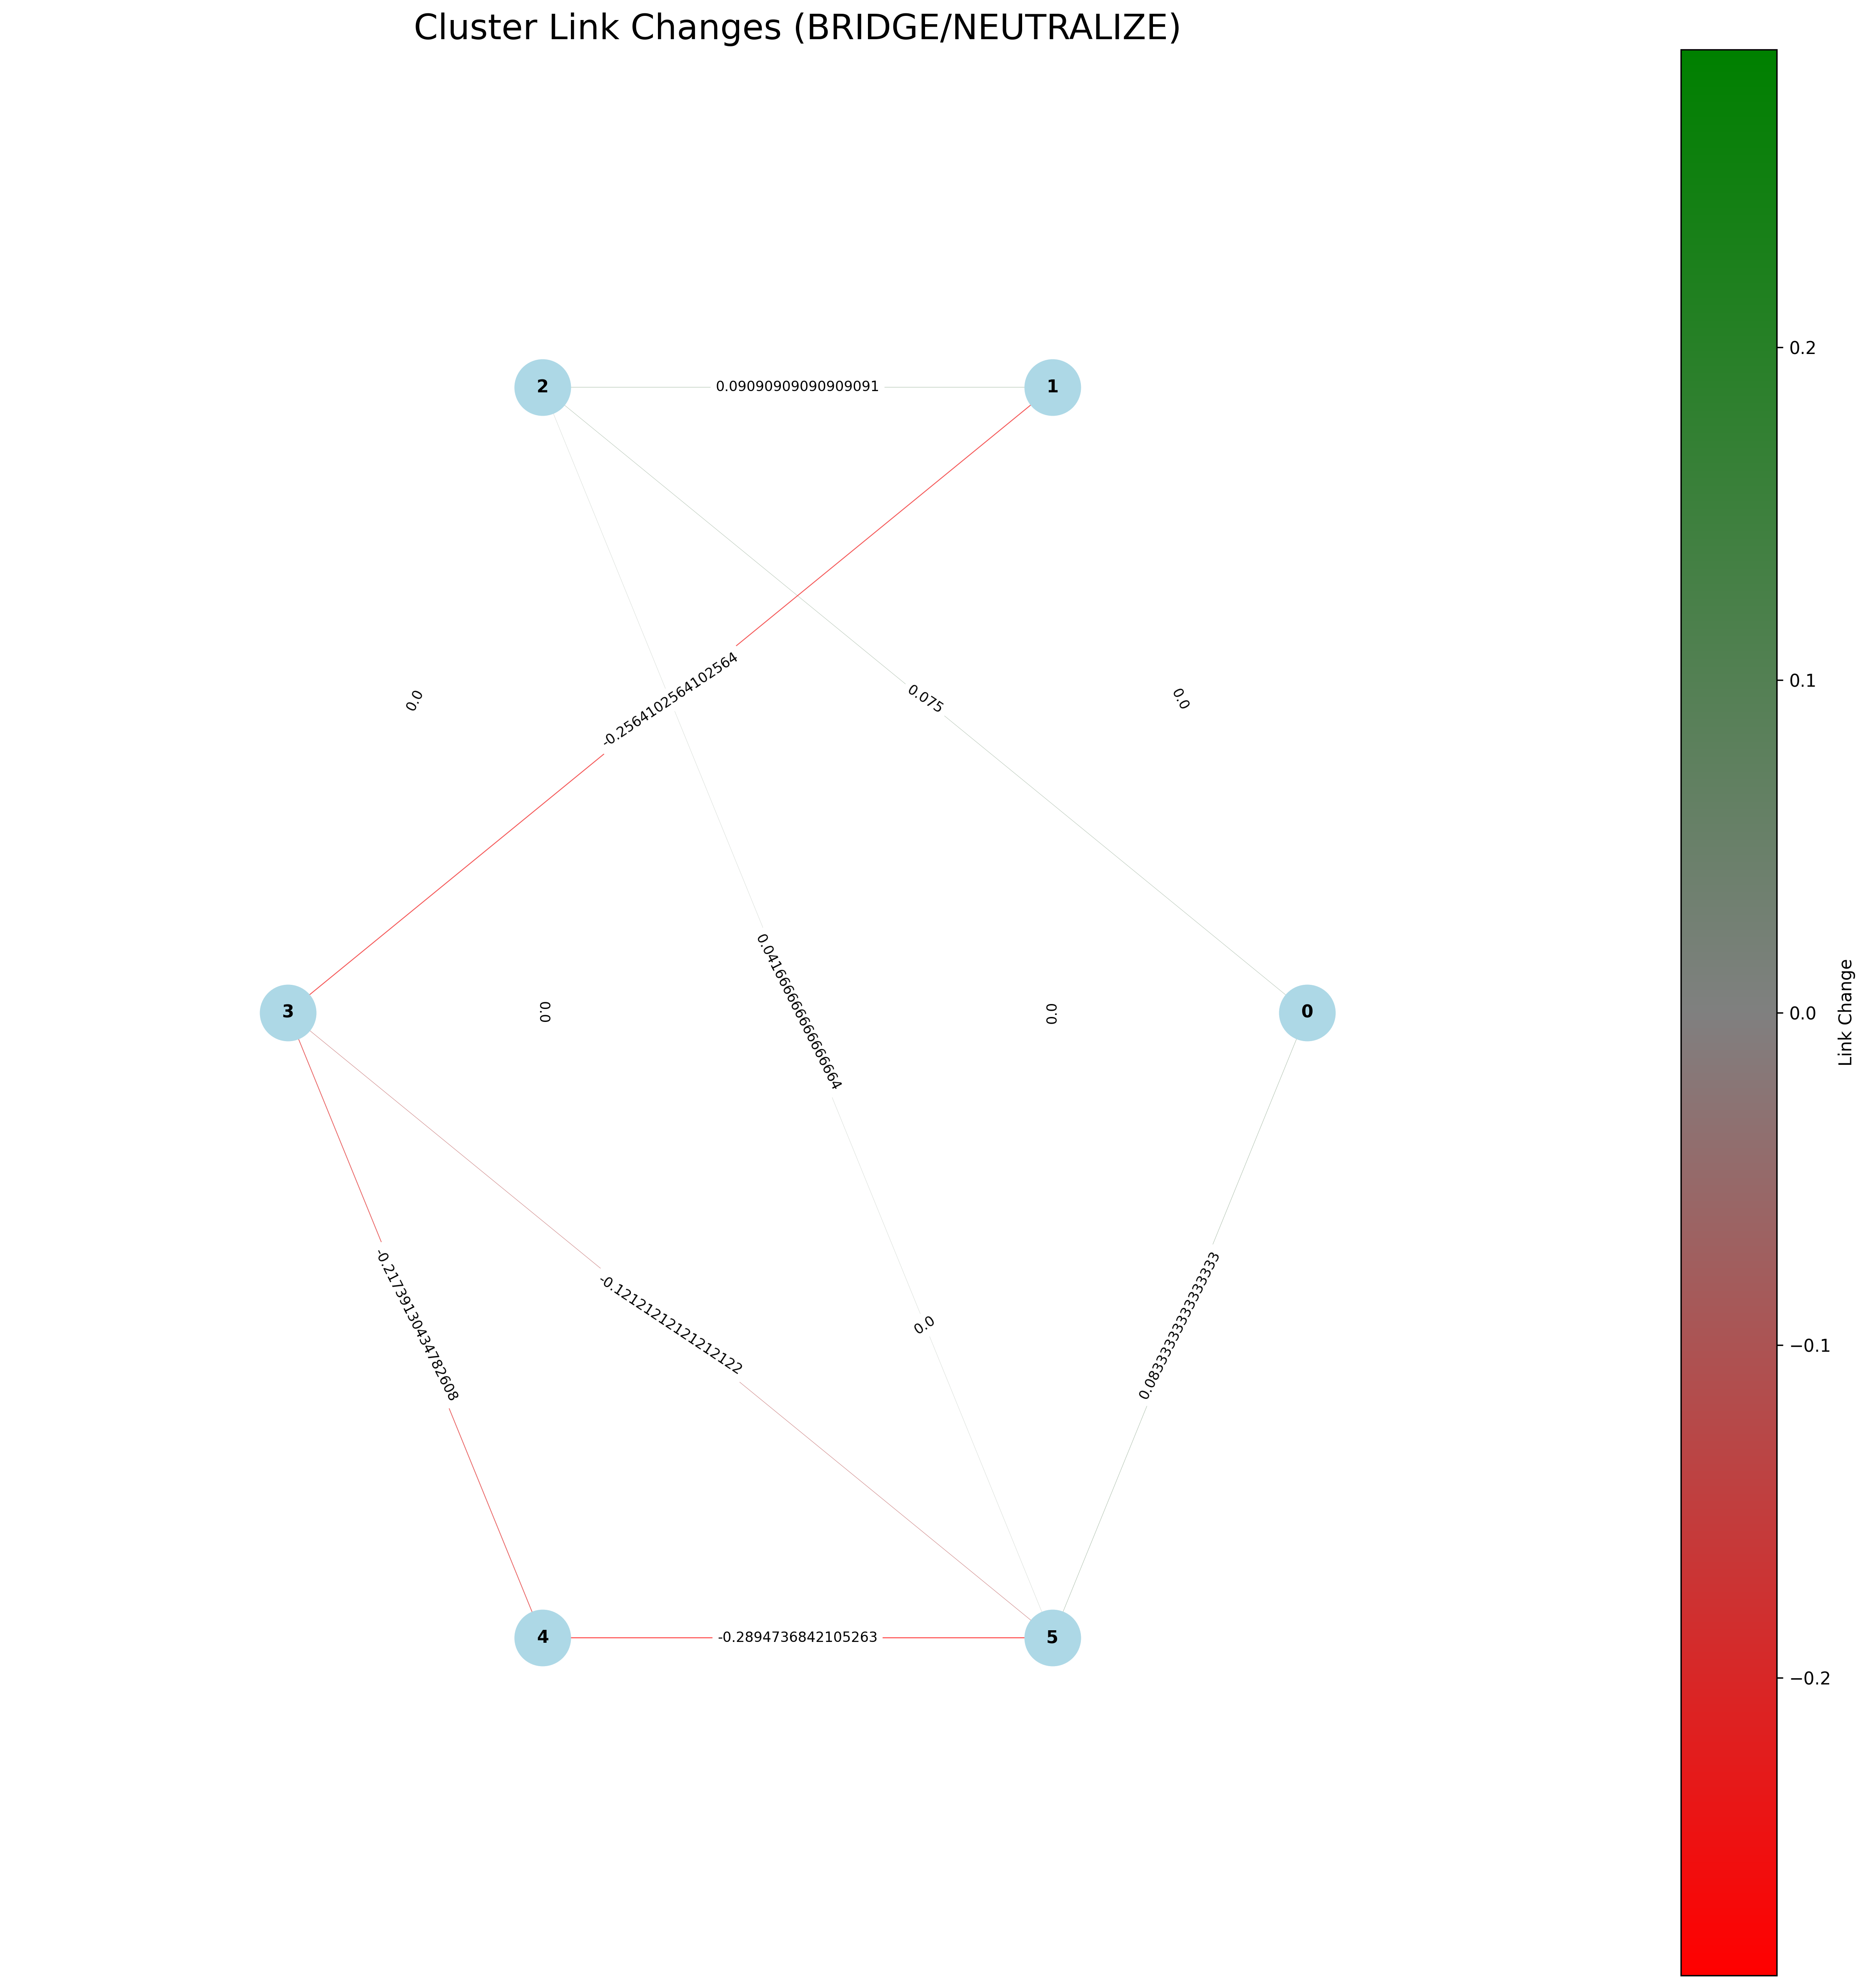
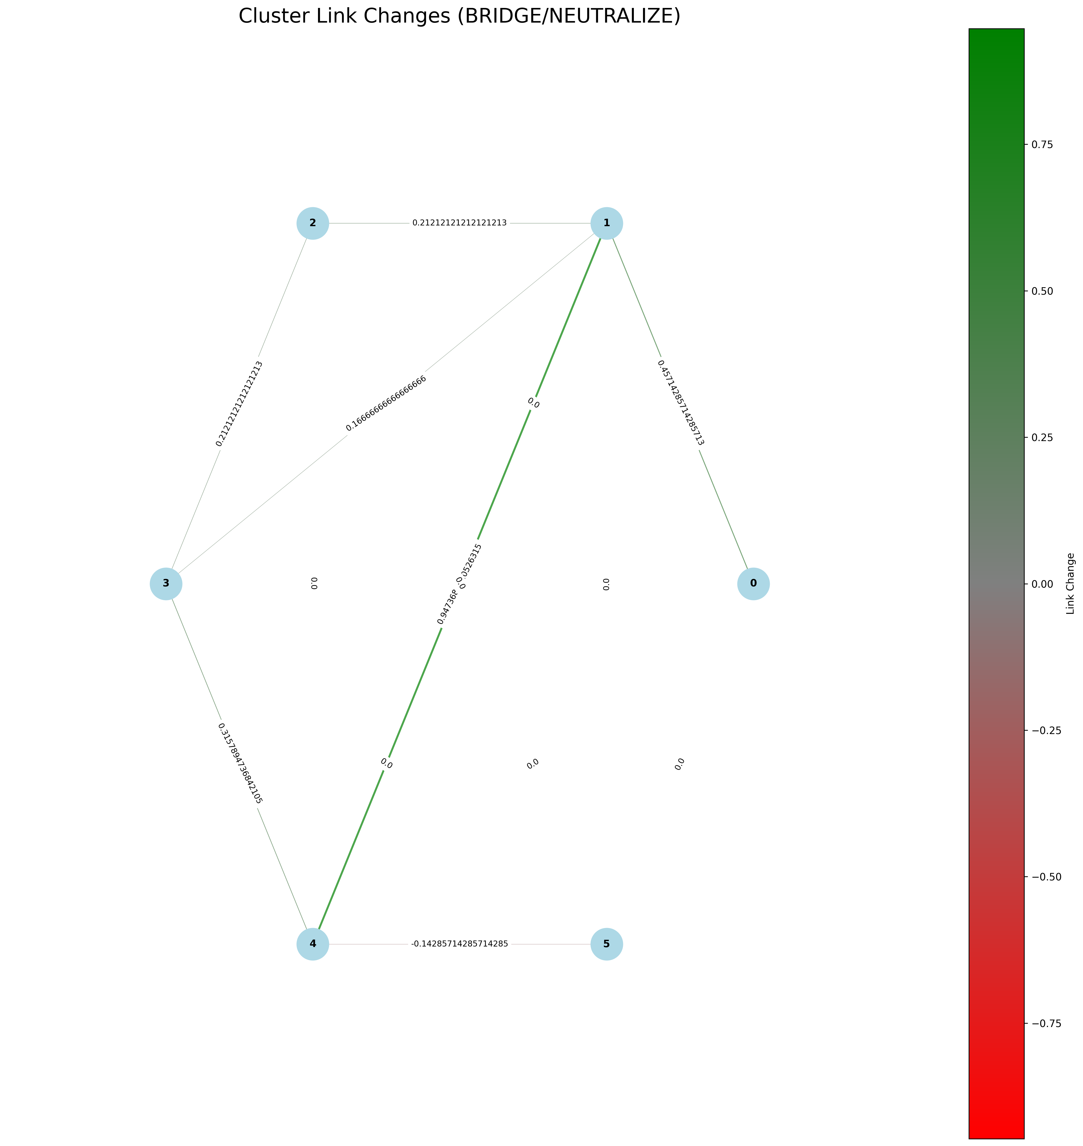
BRIDGE / NEUTRALIZE
Notes:
Picture
Over time
More than one effect
How to do Ensembler of more than one effect
Time period of effects bounded by Day? Month

Slide 40
BOOST / NEGLECT
Name | Definition | Detect
Boost | Discussion or actions that increase the size of a group and/or the connections among group members, or the appearance of such | Target: TOG Communities Measures: Average Path Length Network(s): Agent x Agent (Strong Ties) Indicator: Decrease from t1 to t2
Neglect | Discussion or actions that decrease the size of a group and/or the connections among group members, or the appearance of such | Indicator: Increase from t1 to t2
B
A
B
B
A
B
A
A
C
C
D
C
C
D
Time 1
Time 2
Time 1
Time 2
Notes:
Picture
Over time
More than one effect
How to do Ensembler of more than one effect
Time period of effects bounded by Day? Month

Slide 41
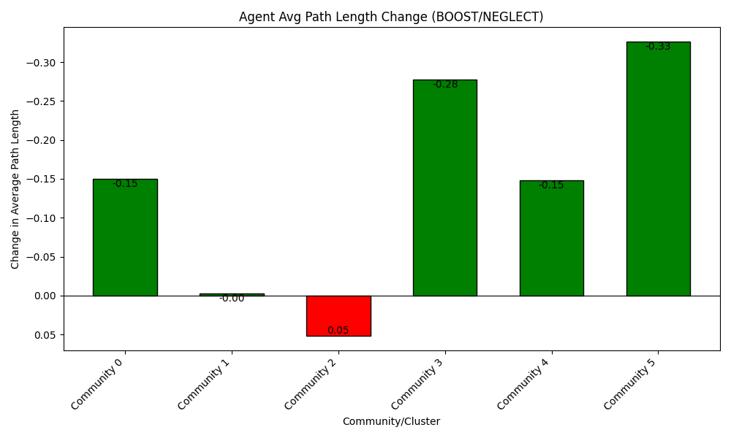
BOOST / NEGLECT
Notes:
Picture
Over time
More than one effect
How to do Ensembler of more than one effect
Time period of effects bounded by Day? Month

Slide 42
BUILD / NARROW
Name | Definition | Detect
Build | Discussion or actions that create a group, or the appearance of a group, where there was none before | Target: TOG Clusters in t1 and t2 Measures: TOG Cluster agent composition Network(s): None Indicator: Single t2 TOG Cluster with no agents from t1 or with agents from multiple t1 TOG Clusters
Narrow | Discussion or actions that lead a group to be, or appear to be, more specialized, and possibly to fission, or appear to fission, into two or more distinct groups | Indicator: Single t1 TOG Cluster with no agents in t2 or with agents now in multiple t2 TOG Clusters
A
B
B
B
A
A
B
A
E
E
C
F
C
D
F
C
C
D
Time 1
Time 2
Time 1
Time 2
Notes:
Picture
Over time
More than one effect
How to do Ensembler of more than one effect
Time period of effects bounded by Day? Month

Slide 43
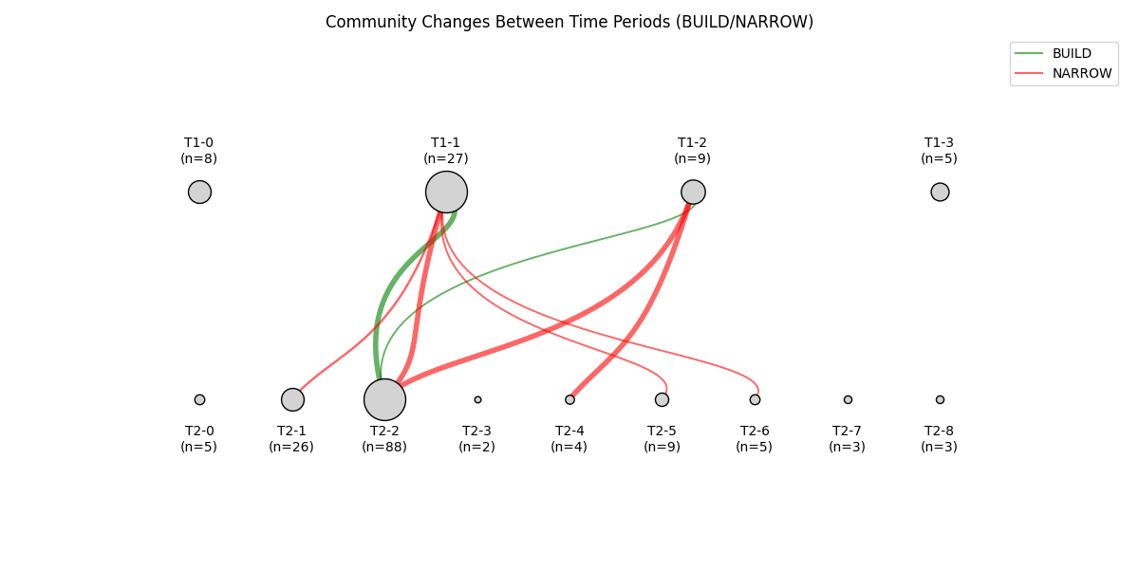
BUILD / NARROW
Notes:
Pie graph per nod on entered and exited, don’t show nodes without lines
Over time
More than one effect
How to do Ensembler of more than one effect
Time period of effects bounded by Day? Month

Slide 44
BACK / NEGATE
Name | Definition | Detect
Back | Discussion or actions that increase the actual, or the appearance of, an actor’s importance or effectiveness relative to a community or topic | Target: All Agents Measures: Centrality across all three – PageRank, Out Degree Centrality (ORA Style), Modularity/Vitality Hub* Network(s): Agent x Agent (Strong Ties) Indicator: Positive change from t1 to t2
Negate | Discussion or actions that decrease the actual, or the appearance of, an actor’s importance or effectiveness relative to a community or topic | Indicator: Negative change from t1 to t2
Already present in ORA-PRO as super-spreaders: Posts Often (out-degree centrality) [Agent x Tweet - Sender]
Often Spread by Others (out-degree centrality) [Agent x Agent - All Propagation]
Iteratively Spread by Others (page rank centrality) [degreeType=outDegree] [Agent x Agent - All Propagation]
Often Spread by Groups of Others (member of large k-core) [degreeType=outDegree] [Agent x Agent - All Propagation]
Notes:
Picture
Over time
More than one effect
How to do Ensembler of more than one effect
Time period of effects bounded by Day? Month

Slide 45
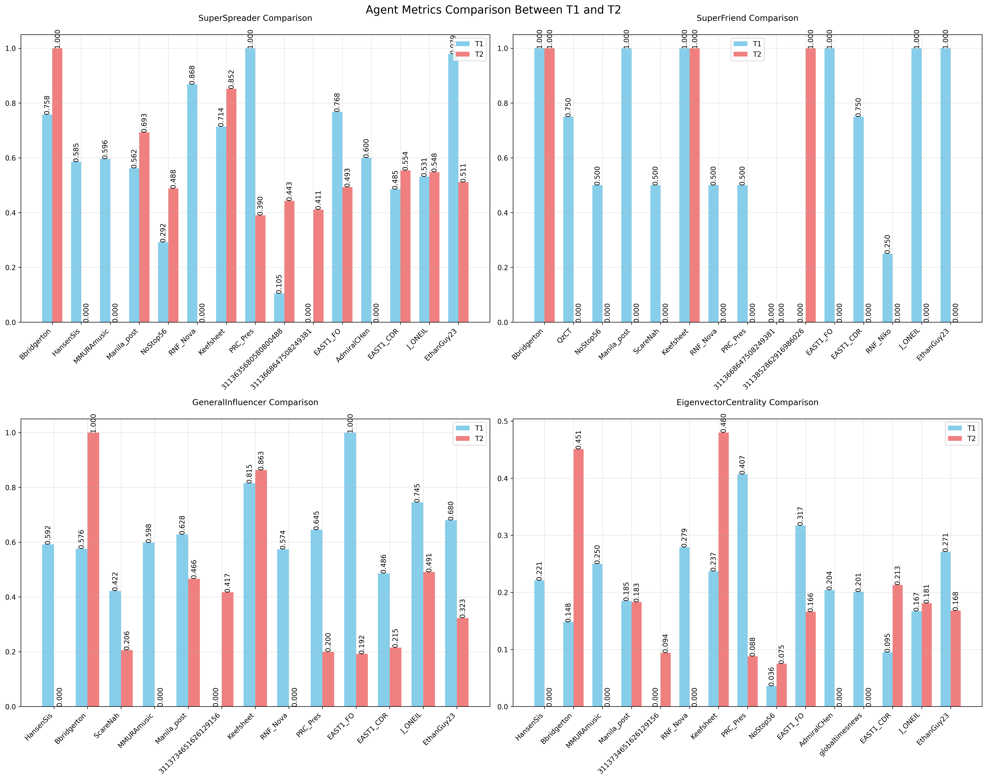
BACK / NEGATE

Slide 46
EXCITE / DISMAY
Name | Definition | Detect
Excite | Discussion or actions related to a community or topic that cause the reader to experience a positive emotion such as joy, happiness, liking, or excitement | Target: TOG Communities Measures: Messages of TOG Cluster agents in t2 and in t1 – evaluate for 4 positive/negative CUEs through NetMapper Network(s): CUEs from NetMapper Indicator: Increase in positive CUEs
Dismay | Discussion or actions related to a community or topic that cause the reader to experience a negative emotion such as worry, sadness, disliking, anger, despair, or fear | Indicator: Increase in negative CUEs
A
☺
A
☺☺☺
A
☹
A
☹☹☹
1
B
☺
1
B
☺☺
1
B
☹
1
B
☹☹
C
☺
C
☺☺☺☺☺
C
☹
C
☹☹☹☹☹
Time 1
Time 2
Time 1
Time 2
Notes:
Count all pos and neg cues = total_cues
T2 pos/total – T1 pos/total = delta pos
T2 neg/total – T1 neg/total = delta neg

Slide 47
EXPLAIN / DISTORT
Name | Definition | Detect
Explain | Discussion or actions that clarify a topic to the targeted community or actor often by providing details on, or elaborations on, the topic | Target: TOG Communities Measures: Average Path Length Network(s): Concept x Concept (Agents in TOG) Indicator: Decrease from t1 to t2
Distort | Discussion or actions that obscure a topic to the targeted community or actor often by supporting a particular point of view or calling details into question | Indicator: Increase from t1 to t2
A
B
A
B
A
B
A
B
C
C
E
C
E
C
Time 1
Time 2
Time 1
Time 2

Slide 48
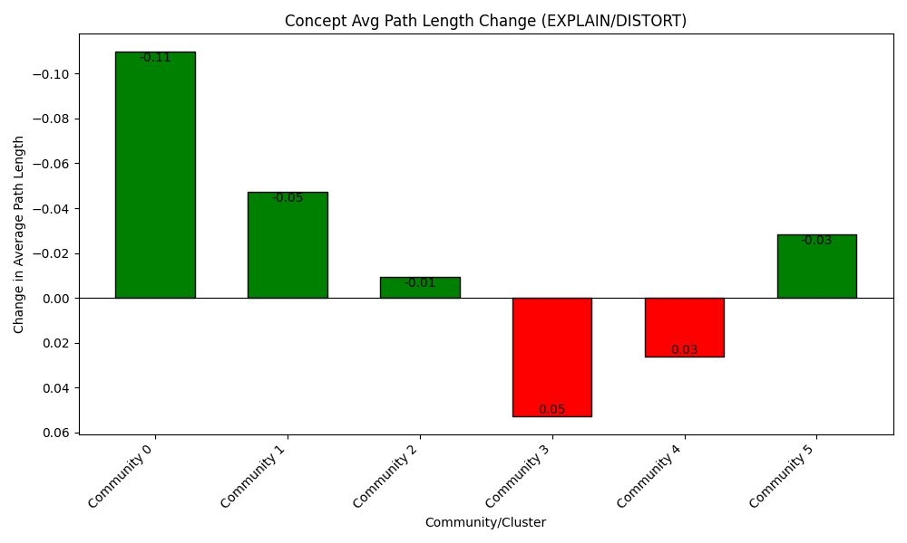
EXPLAIN / DISTORT

Slide 49
ENGAGE / DISMISS
Name | Definition | Detect
Engage | Discussion or actions that increase the relevance of the topic to the reader often by providing anecdotes or enabling direct participation and so suggesting that the reader can impact the topic or will be impacted by it | Target: Each Agent per TOG Community Measures: A) 1st Person pronoun usage, 2) Defining Concept usage (Defining Concepts are those concepts found in both time 1 and time 2) Network(s): Messages (NetMapper CUEs), Agent x Concept Indicator: A) Increase, B) Increase
Dismiss | Discussion or actions that decrease the relevance of the topic to the reader often by providing stories or information that suggest that the reader cannot impact a topic or be impacted by it | Indicator: A) Decrease, B) Decrease
Per Actor
Per Actor
Defining Concepts
A
1st Person: 2
A
1st Person: 20
A
B
A
A
B
1st Person: 2
B
1st Person: 20
A
B
C
C
1st Person: 2
A
B
C
1st Person: 20
D
1st Person: 2
D
1st Person: 20
C
C
Time 1
Time 2

Slide 50
ENHANCE / DISTRACT
Name | Definition | Detect
Enhance | Discussion or actions that provide material that expands the scope of the topic for the targeted community or actor often by making the topic the master topic to which other topics are linked | Target: Agents per TOG Community Measures: Proportional change of concept usage of Defining Concepts (concepts found in both time 1 and time 2 Network(s): Concept x Concept (Agents in TOG) Indicator: Increase or stable proportional usage
Distract | Discussion or actions that redirect the targeted community or actor to a different topic often by bring up unrelated topics, and making the original topic just one of many | Indicator: Decrease of proportional usage
Size of concept nodes are percentage of overall message activity per time. Therefore, we are looking for a decrease in relative percentage of A, B, or C -> replaced by D and E. (Proportional change)
Defining Concepts
D
A
B
A
B
D
A
B
A
A
B
B
C
C
C
C
E
C
E
Time 1
Time 2
Time 1
Time 2

Slide 51
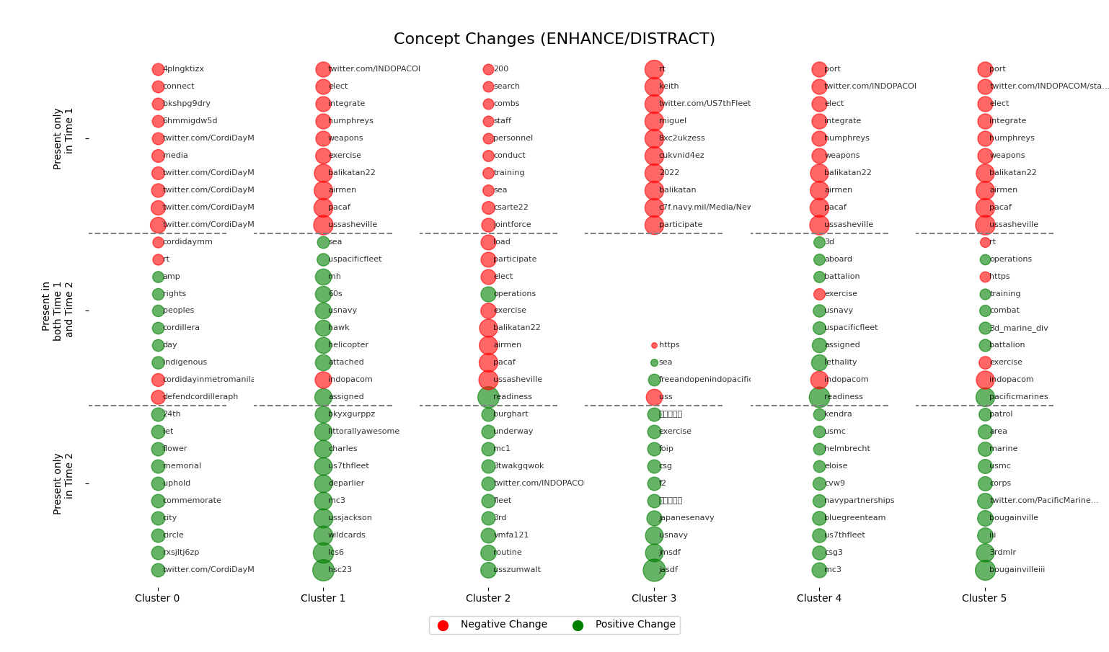
ENHANCE / DISTRACT
Notes:
Pie graph at the bottom of all

Slide 52
Results

Slide 53
Case Studies

Slide 54
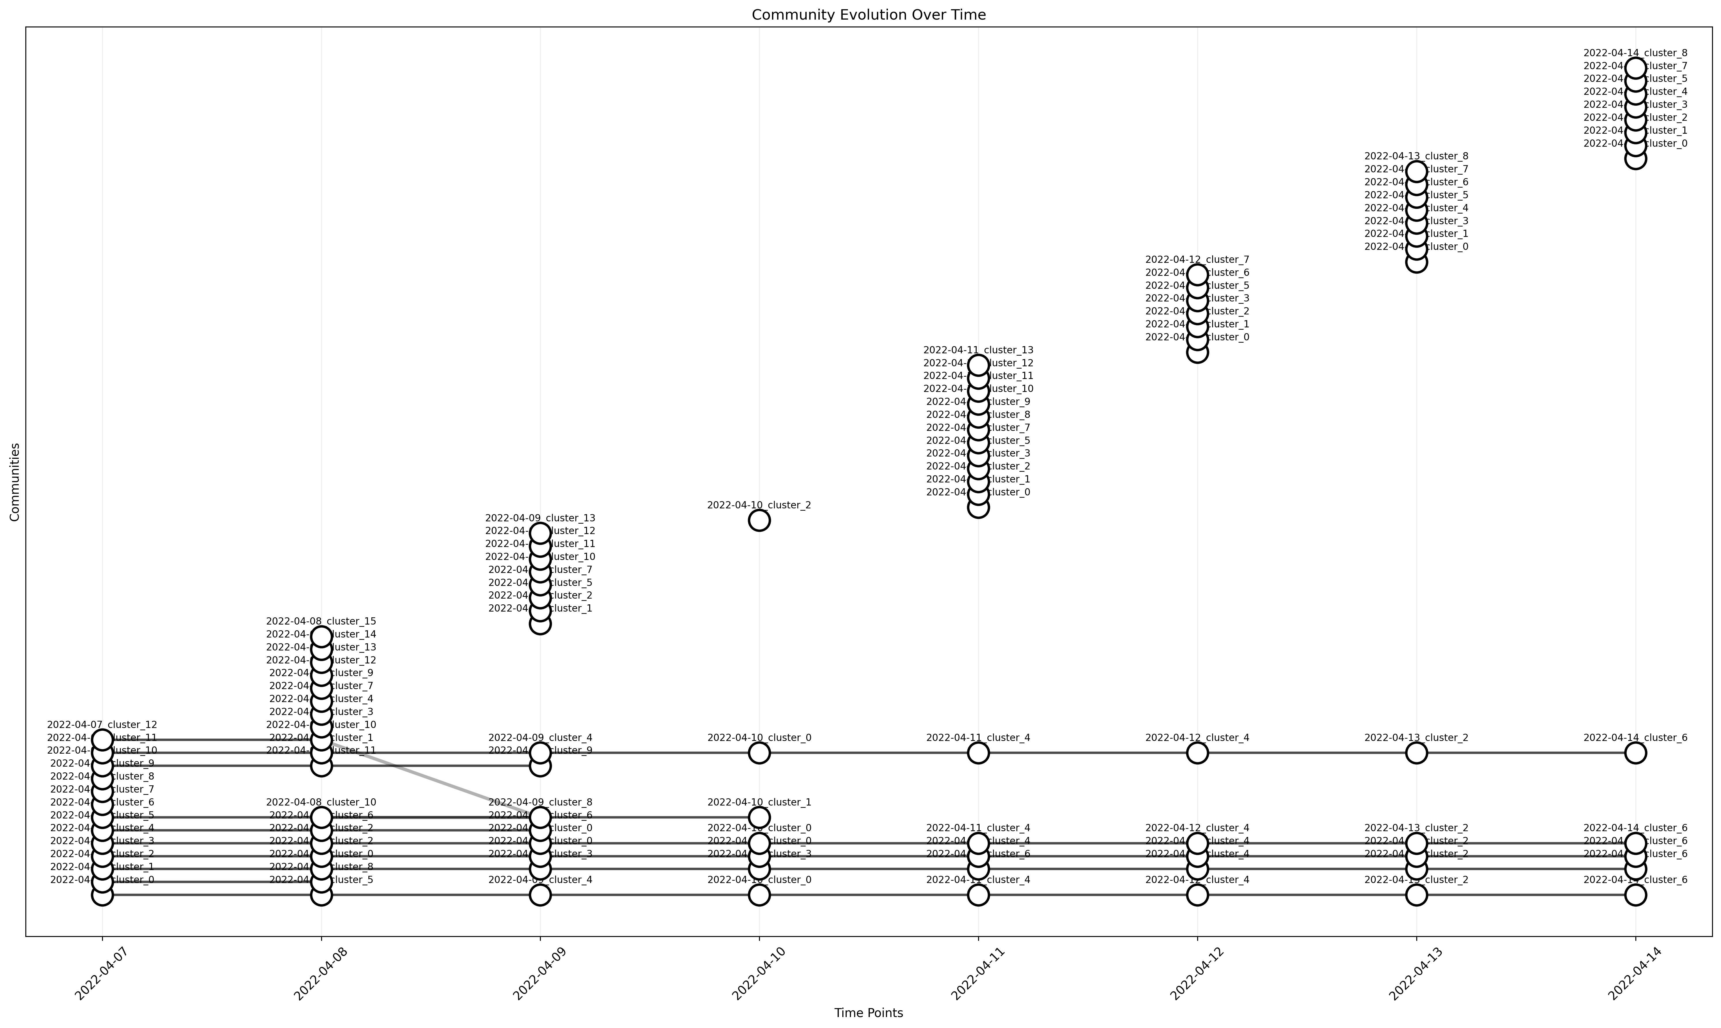
Balikatan 22

Slide 55
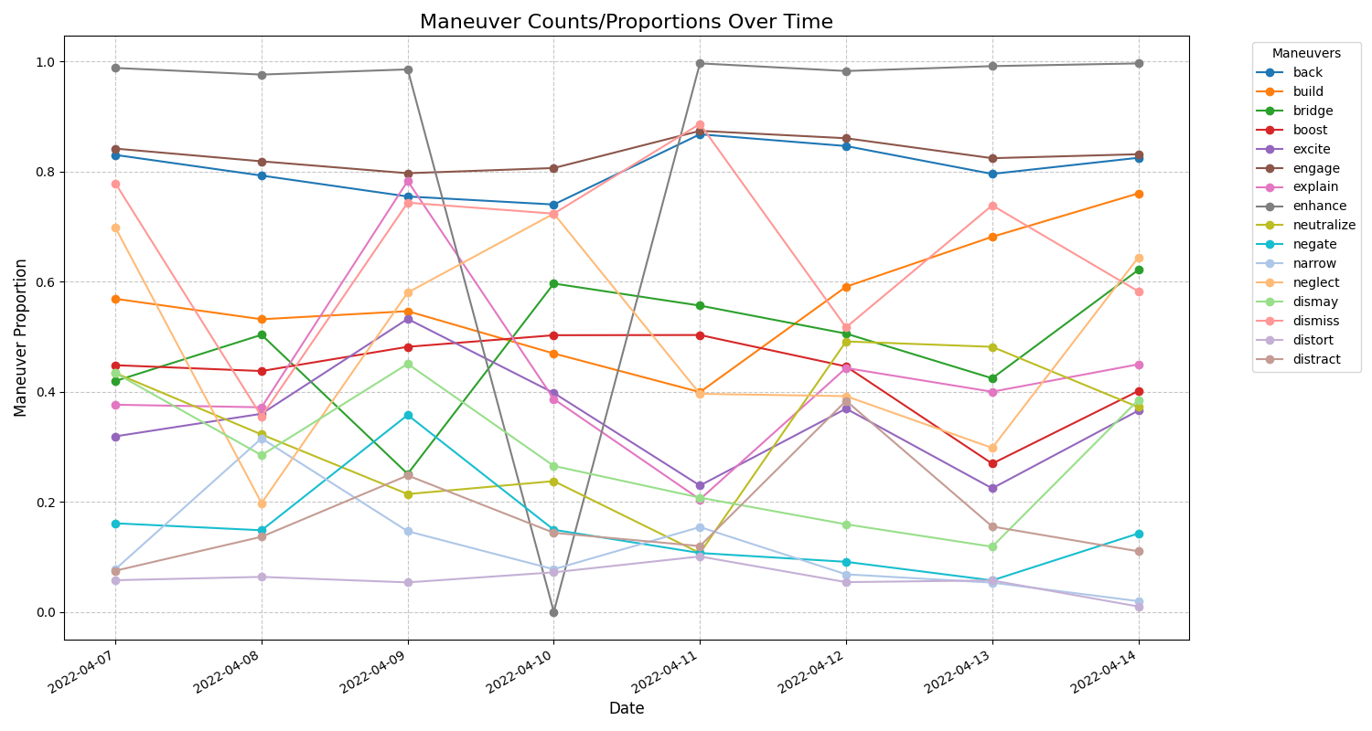
Balikatan 22

Slide 56
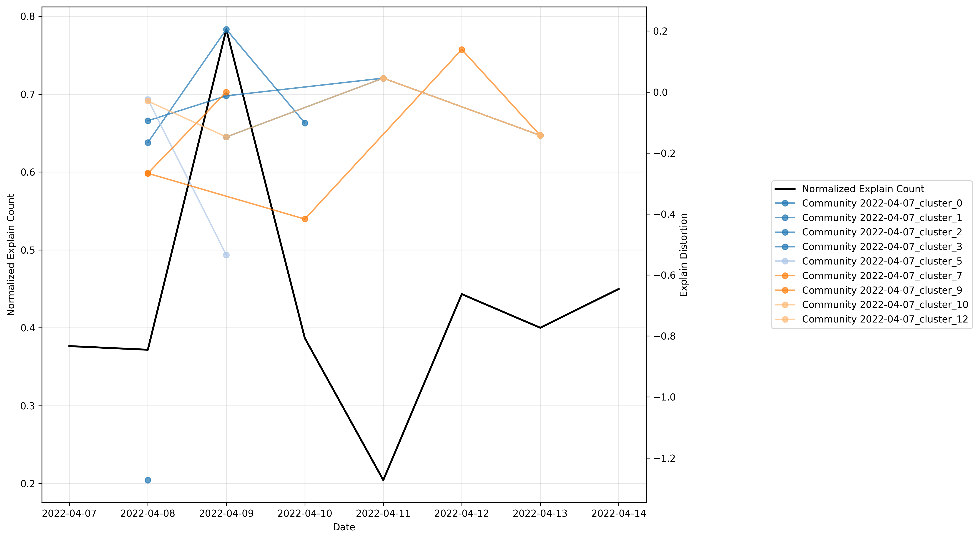
Balikatan 22

Slide 57
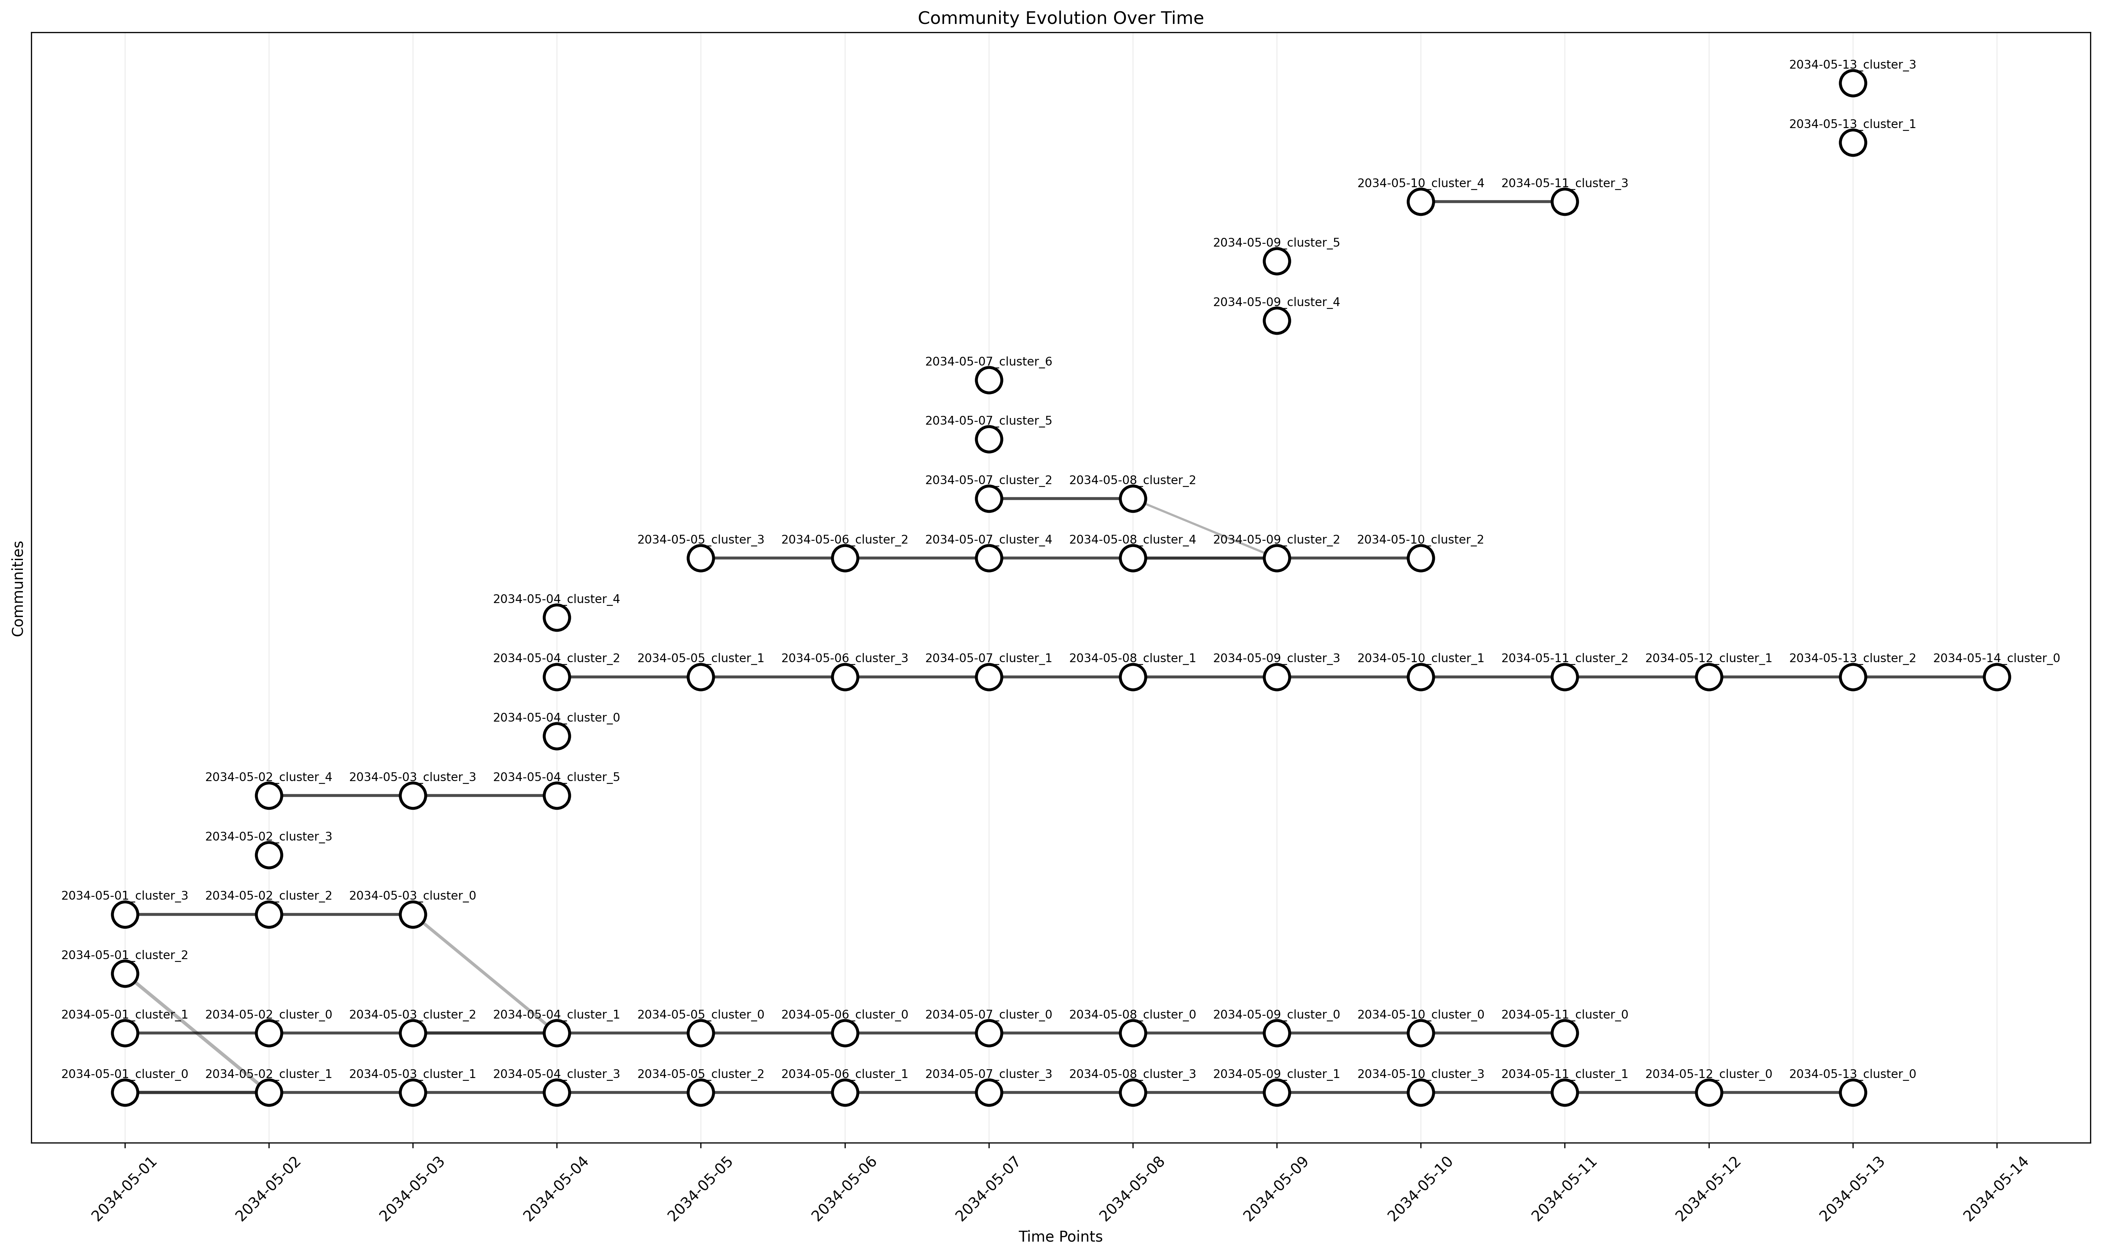
Ring of Fire 2034

Slide 58
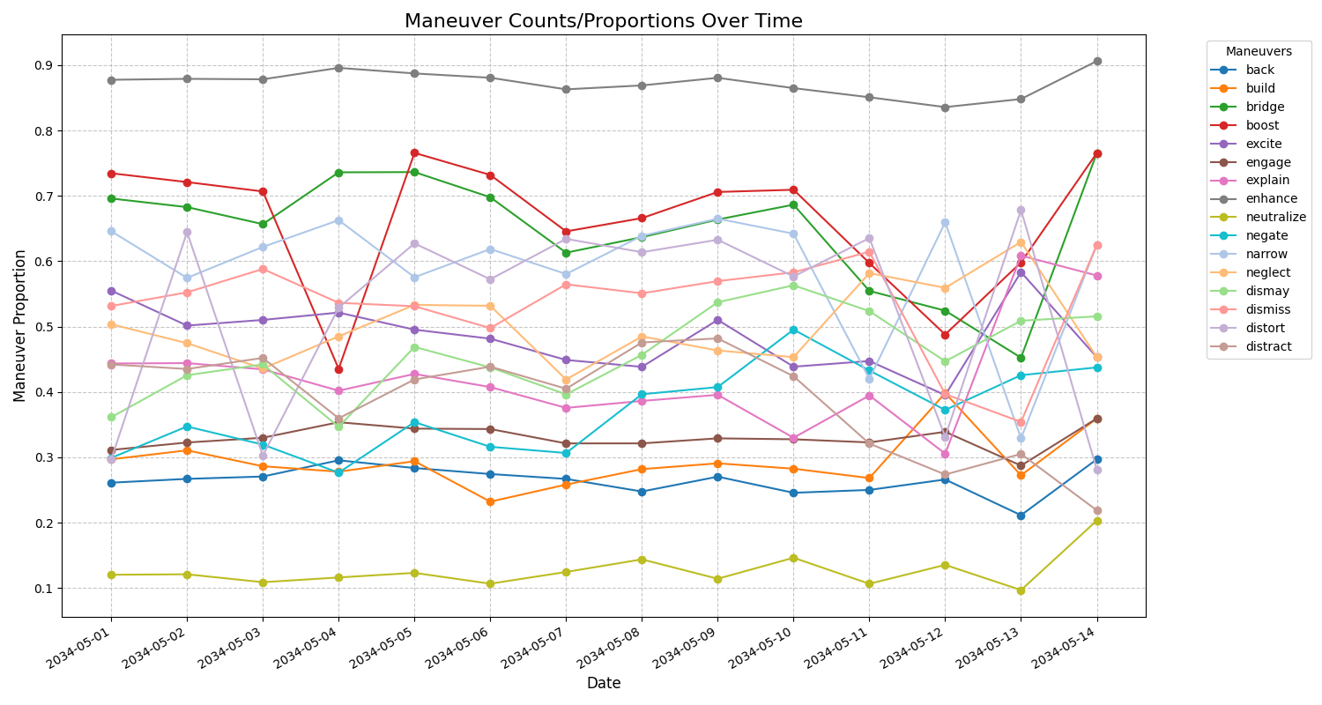
Ring of Fire 2034

Slide 59
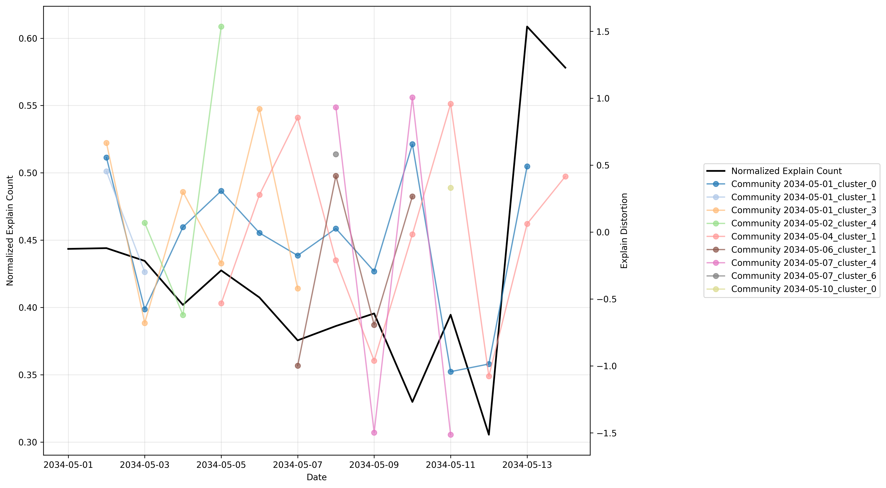
Ring of Fire 2034

Slide 60
Conclusion
Methodological contributions
BEND effects-based detection, which in conjunction with CUE+ allows for a more comprehensive detection mechanism
Application contributions
AI-enabled social media scenario development from existing exercise material or corpora
A draft data standard for passing social media objects and scenarios
AI-enabled X/Twitter and Telegram social media generation for exercise training based on synthetic templates

Slide 61
Limitations and Justifications
BEND Framework Improvements
Additional methods for measuring BEND maneuvers above baseline are required – residual statistics will be more important than net maneuver counts
There is currently no method for directly associating observed BEND effects with any single message BEND maneuver
BEND Scenario Development
Without an overarching simulation, training scenario data will be static; however, AESOP could be used to alter the scenario based upon training audience decisions and the templates could then drive additional synthetic data to get after a highly incremented simulation
Training data should always be a snapshot of the full picture as most social media APIs do not allow for decisively pulling all data possible

Slide 62
Funding and Disclaimer
The research for this thesis was supported in part by the Office of Naval Research (ONR) under grant N00014182106, the United States Army under grant W911NF20D0002, and the center for Informed Democracy and Social-cybersecurity (IDeaS). The views and conclusions are those of the authors and should not be interpreted as representing the official policies, either expressed or implied, of the ONR, the United States Army, or the US Government.
The appearance of U.S. Department of Defense (DoD) visual information does not imply or constitute DoD endorsement.

Slide 63
Future Work

Slide 64
Research Roadmap Timeline

Slide 65
Study 1: Real World Effects
Using existing datasets eliminates external dependencies
CUE+ BEND detection through ORA will be compared against effects-based BEND detection
Correlations between attempted BEND maneuvers (CUE+) and observed BEND maneuvers (effects-based) allow for some measure of effectiveness and for the assessment of countermeasures
Results from BEND Battle can then be compared to ratios of CUE+ detected attempted maneuvers per effects-based detected maneuvers to validate simulated countermeasure effectiveness

Slide 66
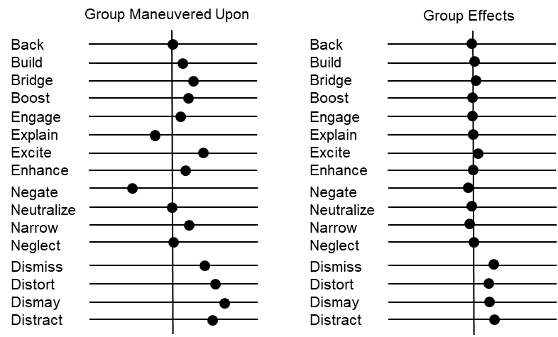
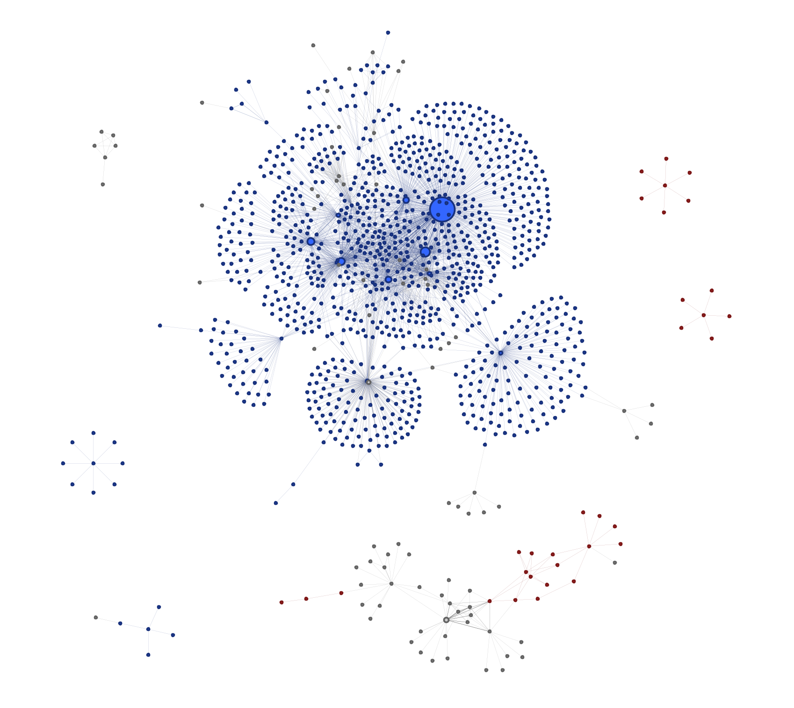
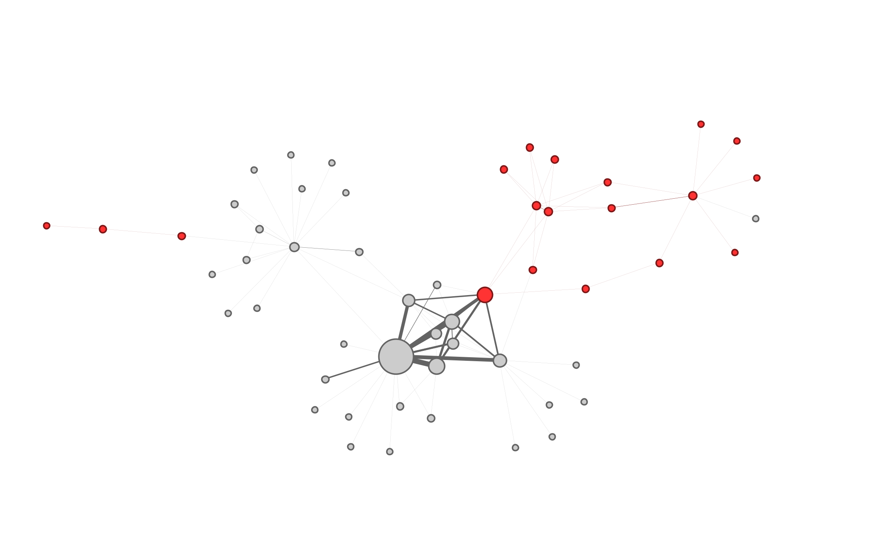
Study 1: Real World Effects
Group Target

Slide 67
Telegram Generation
How many posts?
Channel
Synthetic Generator
Group
Topic/Narratives
n x
Repost?
Topic Selection?
BEND?
Link?
Synthetic Social Media
Start
Prompt Engineering
Get Message
Messages
LLM API Call

Slide 68
AI-Enabled Scenario Orchestration and Planning (AESOP)
Rhetoric, Discourse, Narrative, Story
Group
Stance
Topic
URLs
Actor
Event
News
Twitter Account
Telegram Account

Slide 69
AI-Enabled Scenario Orchestration and Planning (AESOP)
Rhetoric, Discourse, Narrative, Story
Group
Stance
Topic
URLs
Actor
Event
News
Twitter/X Account
Telegram Account
Facebook Account

Slide 70
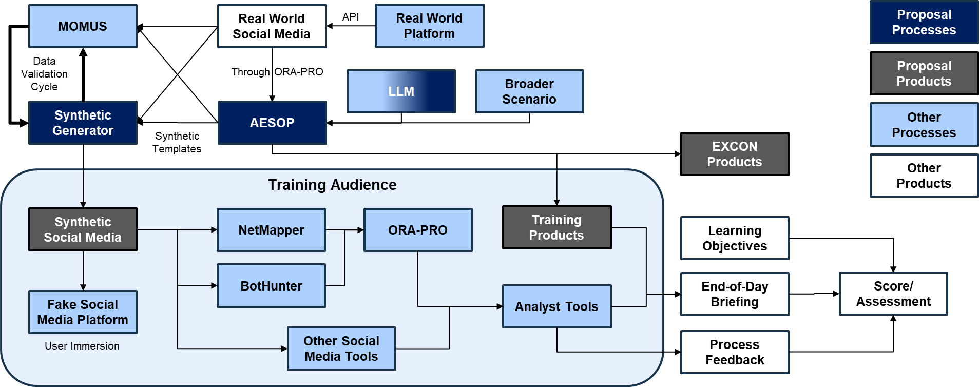
Realistic Training
E
A
D
B
C
G
F

Slide 71
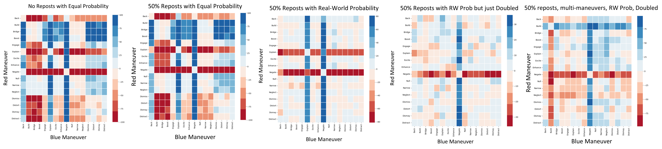
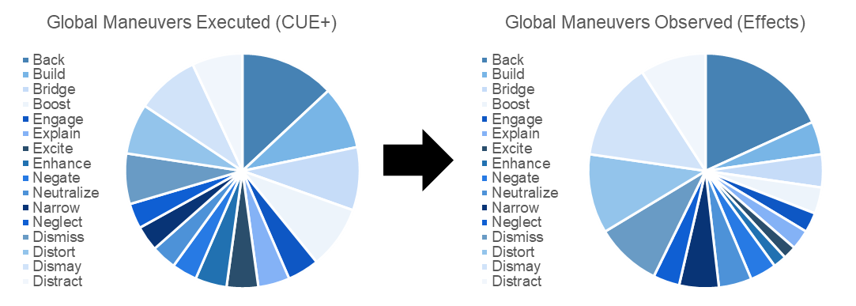
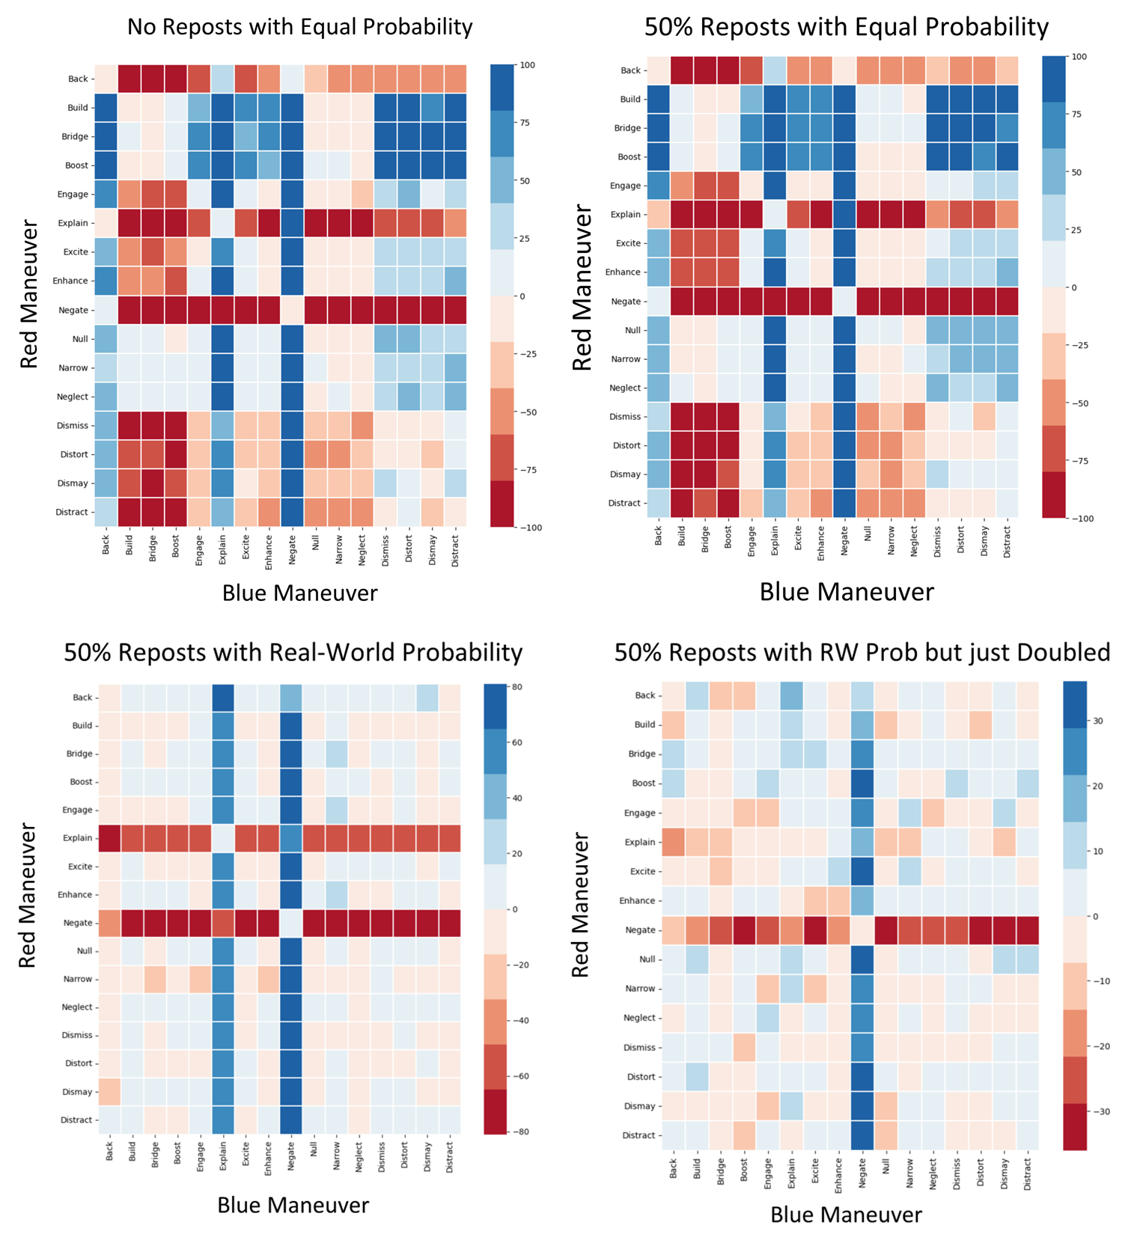


Effects-based Approach
Target Group
CUE+
Effects-based

Slide 72

Effects-based Approach (B)
Name | Definition | Effects-Based Detection
Back | Discussion or actions that increase the actual, or the appearance of, an actor’s importance or effectiveness relative to a community or topic | Centrality in interaction network, importance to group/ changes positively over the time more than the baseline corpus
Build | Discussion or actions that create a group, or the appearance of a group, where there was none before | New group – agent interactions / changes positively over the time more than the baseline corpus
Bridge | Discussion or actions that build a connection between two or more groups or create the appearance of such a connection | Centrality, betweenness of the edge nodes of two groups / changes positively over the time more than the baseline corpus
Boost | Discussion or actions that increase the size of a group and/or the connections among group members, or the appearance of such | Size of group, graph density / changes positively over the time more than the baseline corpus
Excite | Discussion or actions related to a community or topic that cause the reader to experience a positive emotion such as joy, happiness, liking, or excitement | Target packet emotional valence will be higher in happiness and surprise / changes positively over the time more than the baseline corpus
Explain | Discussion or actions that clarify a topic to the targeted community or actor often by providing details on, or elaborations on, the topic | Topic specialization – additional jargon and net shift towards same stance / changes over the time more than the baseline corpus
Engage | Discussion or actions that increase the relevance of the topic to the reader often by providing anecdotes or enabling direct participation and so suggesting that the reader can impact the topic or will be impacted by it | Topics proportional representation / changes positively over the time more than the baseline corpus
Enhance | Discussion or actions that provide material that expands the scope of the topic for the targeted community or actor often by making the topic the master topic to which other topics are linked | Increased linkage and centrality, betweenness / changes positively over the time more than the baseline corpus
Negate | Discussion or actions that decrease the actual, or the appearance of, an actor’s importance or effectiveness relative to a community or topic | Centrality of node / changes negatively over the time more than the baseline corpus
Neutralize | Discussion or actions that cause a group to be, or appear to be, no longer of relevance, e.g., because it was dismantled | Group nodes have more in common with other groups than themselves (group disappears)
Narrow | Discussion or actions that lead a group to be, or appear to be, more specialized, and possibly to fission, or appear to fission, into two or more distinct groups | Multiple groups where only one was present before, fewer links on bipartite network from meta-agent group node to topic/stance nodes
Neglect | Discussion or actions that decrease the size of a group and/or the connections among group members, or the appearance of such | Density and/or size / changes negatively over the time above the baseline corpus
Dismay | Discussion or actions related to a community or topic that cause the reader to experience a negative emotion such as worry, sadness, disliking, anger, despair, or fear | Target packet emotional valence will be higher in anger, sadness, fear / changes over the time more than the baseline corpus
Distort | Discussion or actions that obscure a topic to the targeted community or actor often by supporting a particular point of view or calling details into question | Topic specialization – additional jargon and net shift towards opposite stance / changes over the time more than the baseline corpus
Dismiss | Discussion or actions that decrease the relevance of the topic to the reader often by providing stories or information that suggest that the reader cannot impact a topic or be impacted by it | Topics proportional representation / changes negatively over the time more than the baseline corpus
Distract | Discussion or actions that redirect the targeted community or actor to a different topic often by bring up unrelated topics, and making the original topic just one of many | Decreased linkage and centrality, betweenness / changes over the time more than the baseline corpus
Name | Definition | Effects-Based Detection
Back | Discussion or actions that increase the actual, or the appearance of, an actor’s importance or effectiveness relative to a community or topic | Centrality in interaction network, importance to group/ changes positively over the time more than the baseline corpus
Build | Discussion or actions that create a group, or the appearance of a group, where there was none before | New group – agent interactions / changes positively over the time more than the baseline corpus
Bridge | Discussion or actions that build a connection between two or more groups or create the appearance of such a connection | Centrality, betweenness of the edge nodes of two groups / changes positively over the time more than the baseline corpus
Boost | Discussion or actions that increase the size of a group and/or the connections among group members, or the appearance of such | Size of group, graph density / changes positively over the time more than the baseline corpus
Excite | Discussion or actions related to a community or topic that cause the reader to experience a positive emotion such as joy, happiness, liking, or excitement | Target packet emotional valence will be higher in happiness and surprise / changes positively over the time more than the baseline corpus
Explain | Discussion or actions that clarify a topic to the targeted community or actor often by providing details on, or elaborations on, the topic | Topic specialization – additional jargon and net shift towards same stance / changes over the time more than the baseline corpus
Engage | Discussion or actions that increase the relevance of the topic to the reader often by providing anecdotes or enabling direct participation and so suggesting that the reader can impact the topic or will be impacted by it | Topics proportional representation / changes positively over the time more than the baseline corpus
Enhance | Discussion or actions that provide material that expands the scope of the topic for the targeted community or actor often by making the topic the master topic to which other topics are linked | Increased linkage and centrality, betweenness / changes positively over the time more than the baseline corpus
Negate | Discussion or actions that decrease the actual, or the appearance of, an actor’s importance or effectiveness relative to a community or topic | Centrality of node / changes negatively over the time more than the baseline corpus
Neutralize | Discussion or actions that cause a group to be, or appear to be, no longer of relevance, e.g., because it was dismantled | Group nodes have more in common with other groups than themselves (group disappears)
Narrow | Discussion or actions that lead a group to be, or appear to be, more specialized, and possibly to fission, or appear to fission, into two or more distinct groups | Multiple groups where only one was present before, fewer links on bipartite network from meta-agent group node to topic/stance nodes
Neglect | Discussion or actions that decrease the size of a group and/or the connections among group members, or the appearance of such | Density and/or size / changes negatively over the time above the baseline corpus
Dismay | Discussion or actions related to a community or topic that cause the reader to experience a negative emotion such as worry, sadness, disliking, anger, despair, or fear | Target packet emotional valence will be higher in anger, sadness, fear / changes over the time more than the baseline corpus
Distort | Discussion or actions that obscure a topic to the targeted community or actor often by supporting a particular point of view or calling details into question | Topic specialization – additional jargon and net shift towards opposite stance / changes over the time more than the baseline corpus
Dismiss | Discussion or actions that decrease the relevance of the topic to the reader often by providing stories or information that suggest that the reader cannot impact a topic or be impacted by it | Topics proportional representation / changes negatively over the time more than the baseline corpus
Distract | Discussion or actions that redirect the targeted community or actor to a different topic often by bring up unrelated topics, and making the original topic just one of many | Decreased linkage and centrality, betweenness / changes over the time more than the baseline corpus
Notes:
Picture
Over time
More than one effect
How to do Ensembler of more than one effect
Time period of effects bounded by Day? Month

Slide 73
Scenario Training
Understanding the BEND framework within existing doctrine, identifying BEND and its effects, and even conceptually knowing countermeasures falls short of fully operationalizing BEND
Effective BEND operationalization requires realistic training on a realistic corpus

